Slide 1
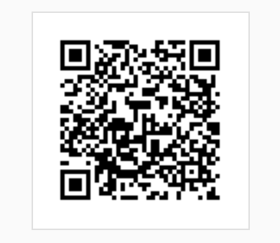
National Cancer Institute
Cloud Resources
ACM-BCM Workshop, Wash. DC
August 29, 2018
https://goo.gl/f21Lqq

Slide 2
Disclaimer
The opinions/comments/assessment expressed in this presentation are the author’s own and do not necessarily reflect the view of the National Cancer Institute or National Institutes of Health.
https://ethics.od.nih.gov/topics/Disclaimer.htm

Slide 3
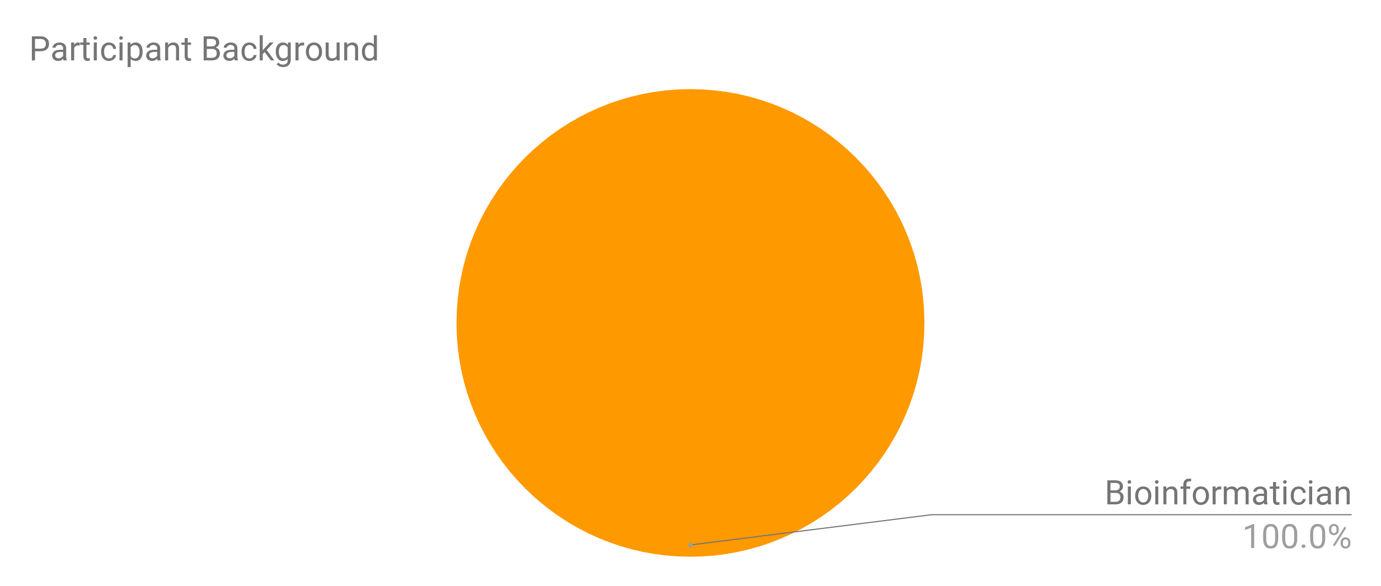
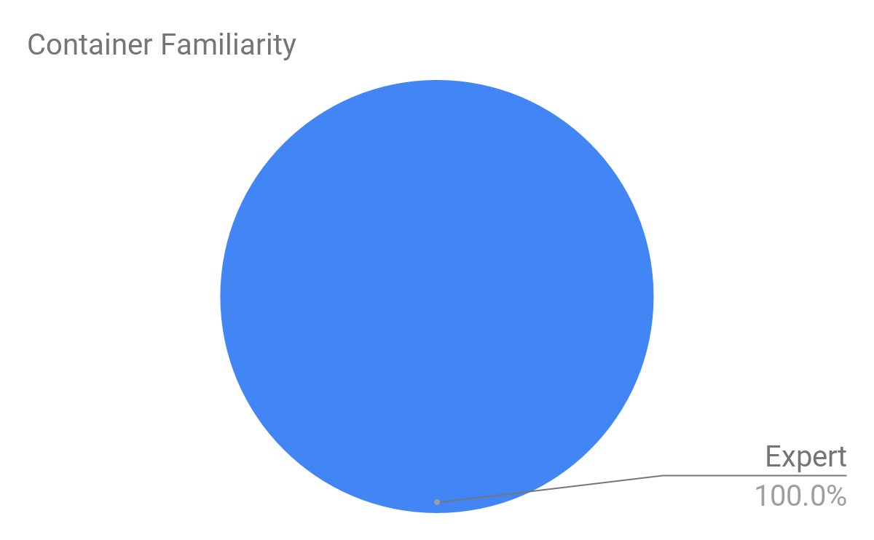
Audience

Slide 4
Agenda - 8/29/2018 ACM-BCB Workshop
1:00-2:00 PM Overview of NCI Cloud Resources
Account setup
Introduction to software containers and workflows on the NCI Cloud Resources
2:00-3:00 PM Broad Institute’s FireCloud
3:00-4:00 PM Seven Bridges Cancer Genomics Cloud
4:00-5:00 PM Institute for Systems Biology Cancer Genomics Cloud/Q&A

Slide 5
Overview of NCI Cloud Resources
Presenter: Steve Tsang

Slide 6
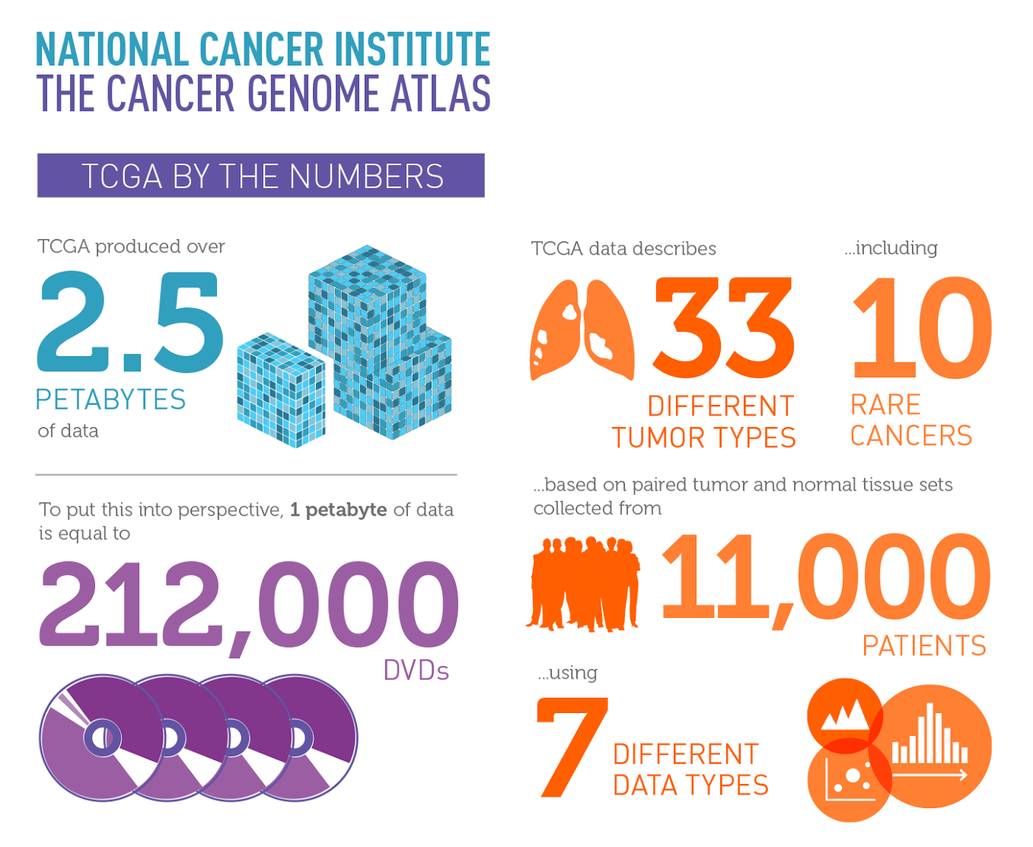
Cancer Genomic Data Challenges
> 2.5 PB of TCGA data (WXS, RNASeq, WGS)
Fragmentary repositories of cancer genomic data
TCGA, TARGET and CGCI had their own data repositories (DCCs)
Sequencing data: BAM files at CGhub while VCF/MAF files at DCC
Assuming the 2.5 PB TCGA data set
Storage and Data Protection would cost approximately $2,000,000 per year
Downloading TCGA data at 10 Gb/sec = 23 days
Only large institutions could utilize this data
These data types continued to grow

Slide 7
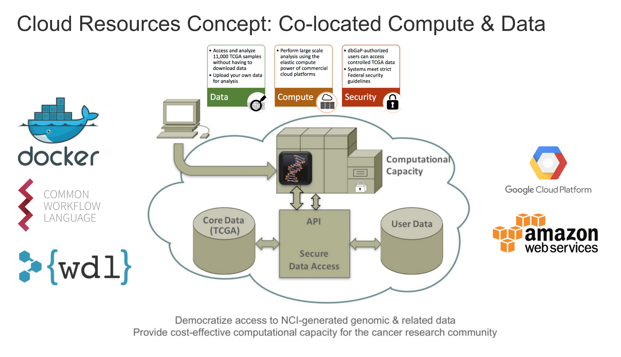

Slide 8
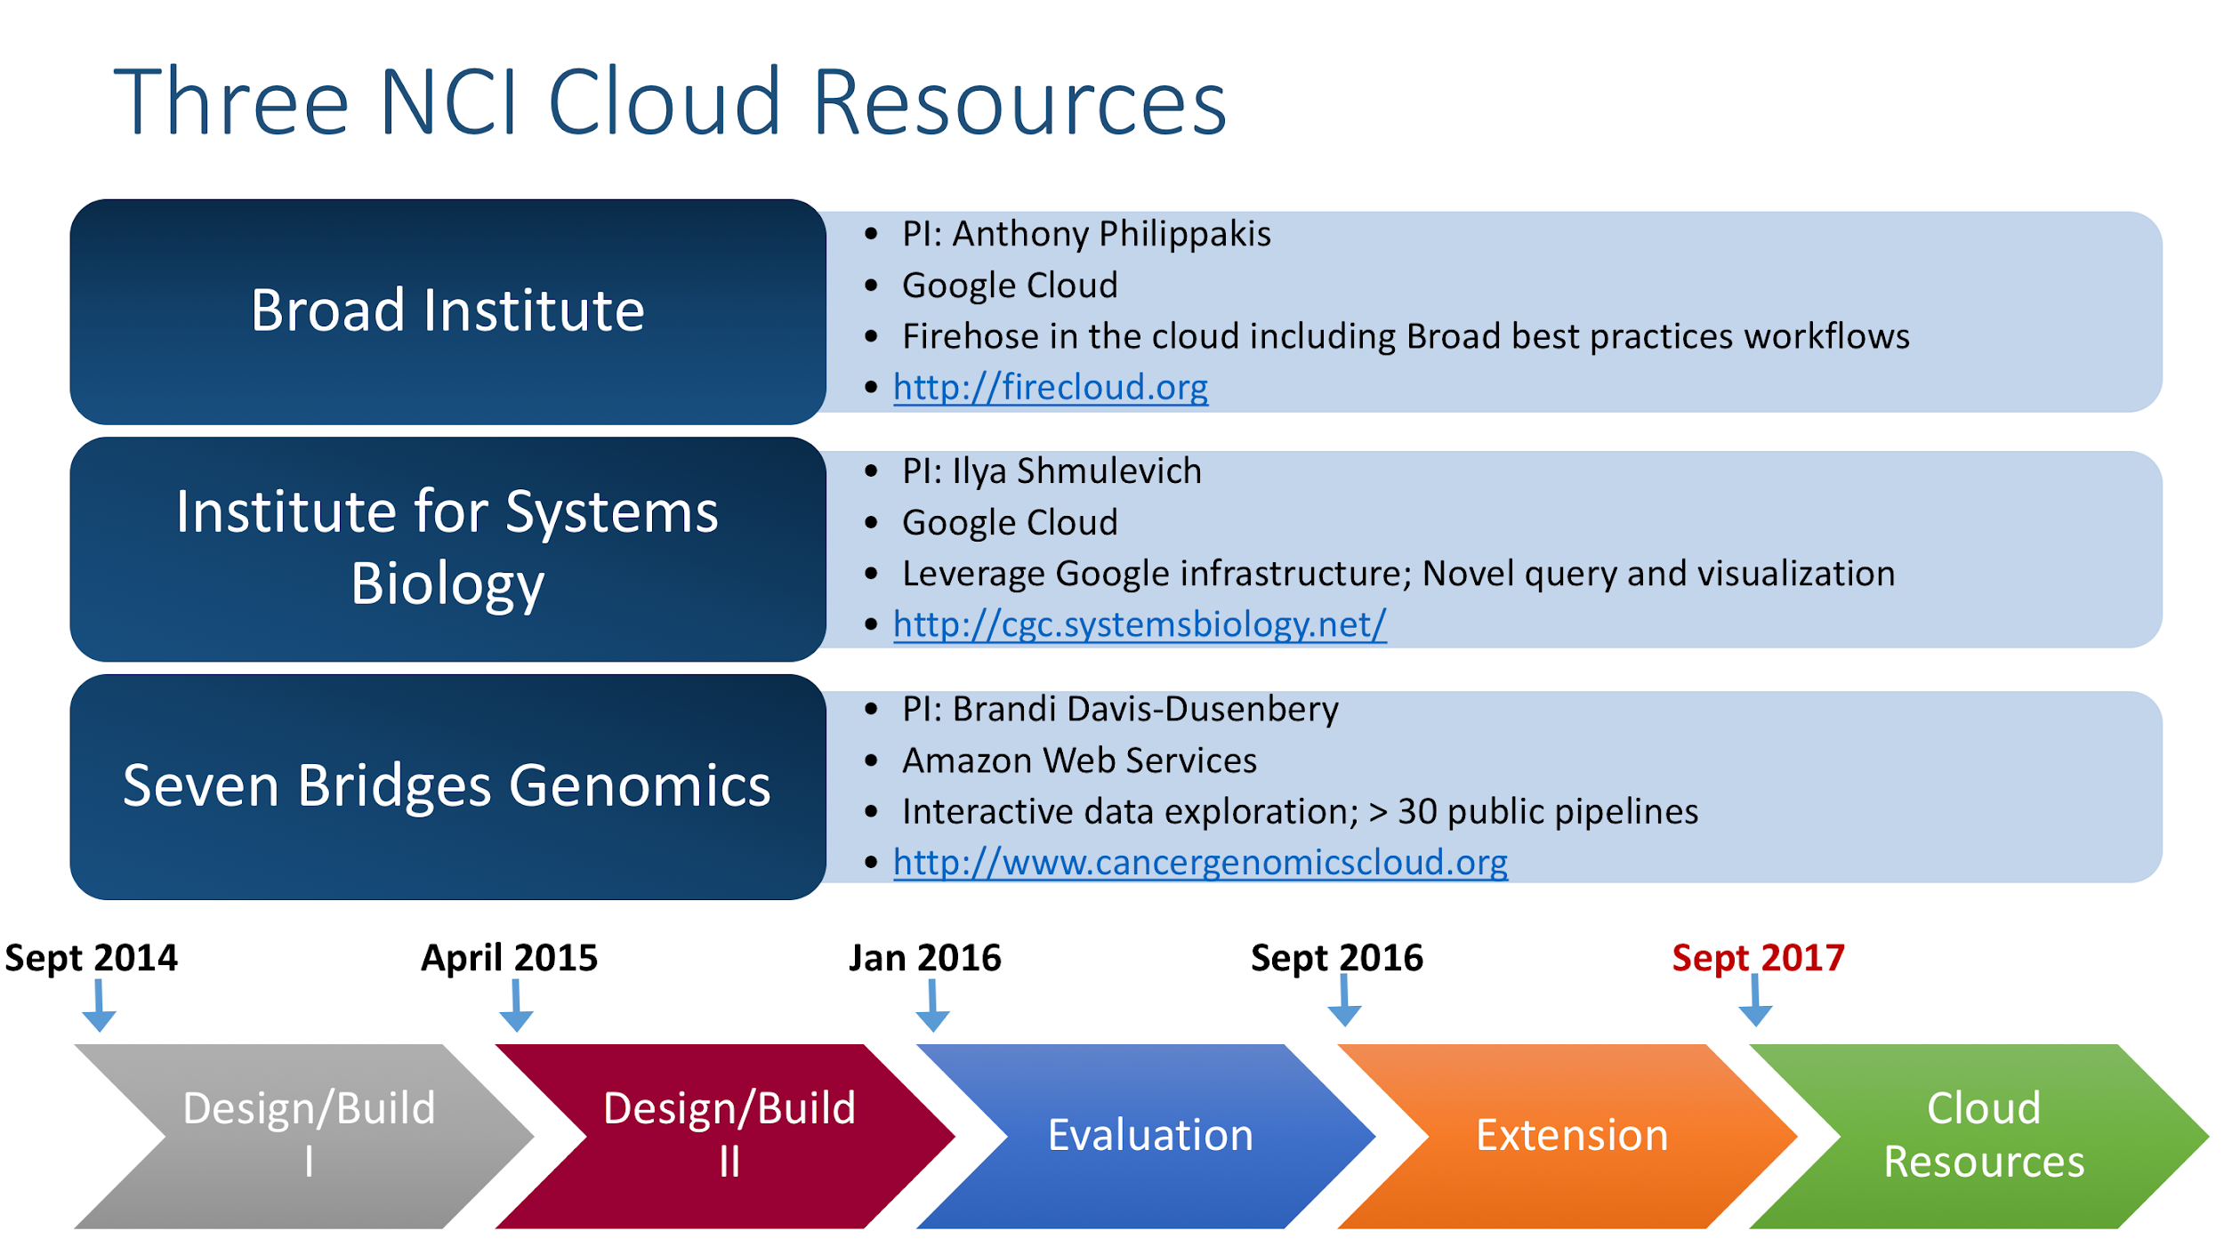

Slide 9
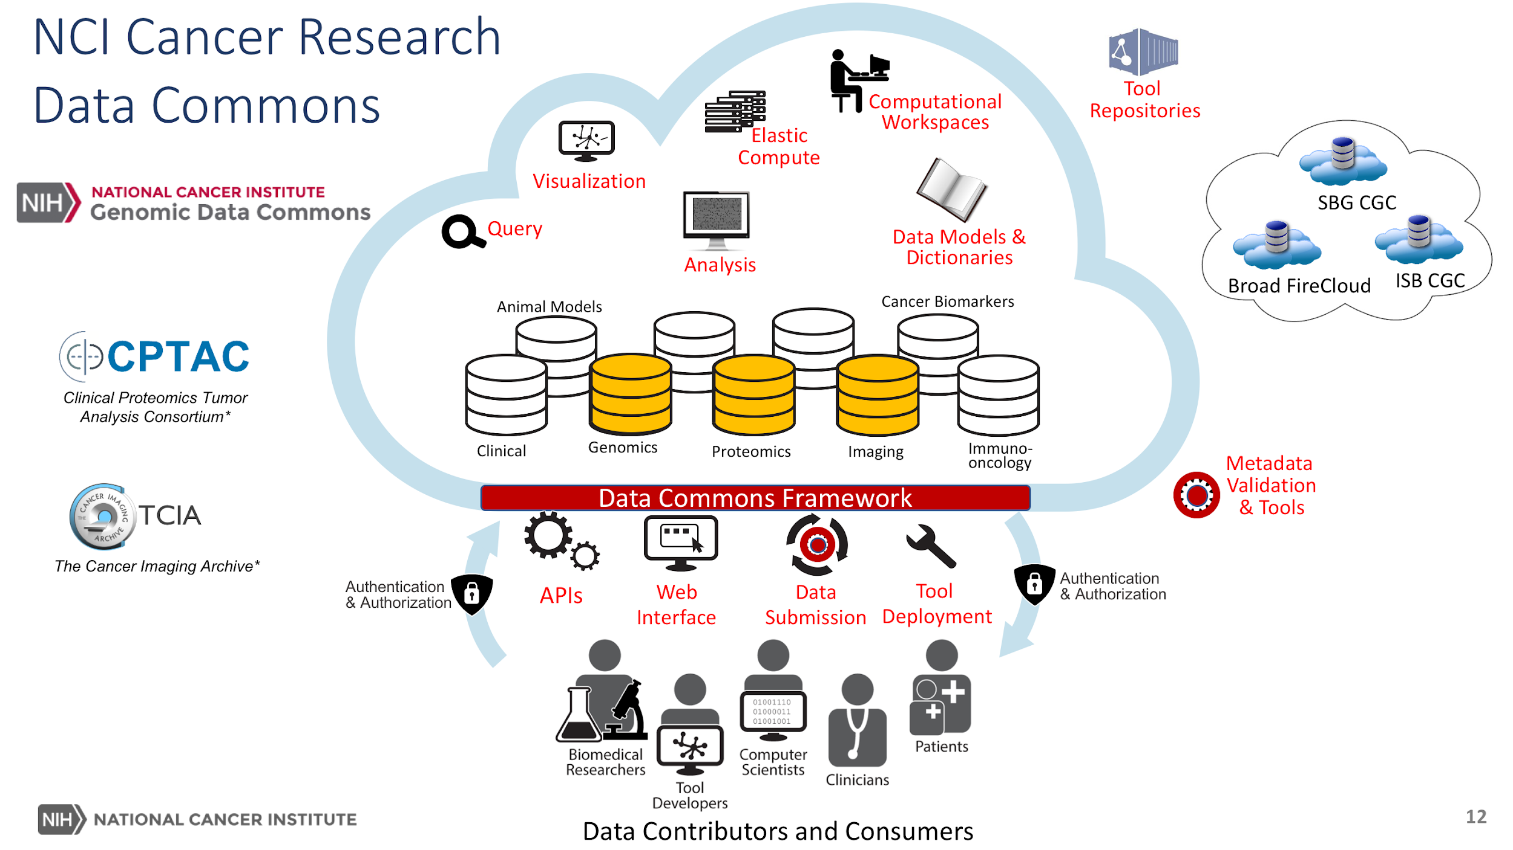

Slide 10
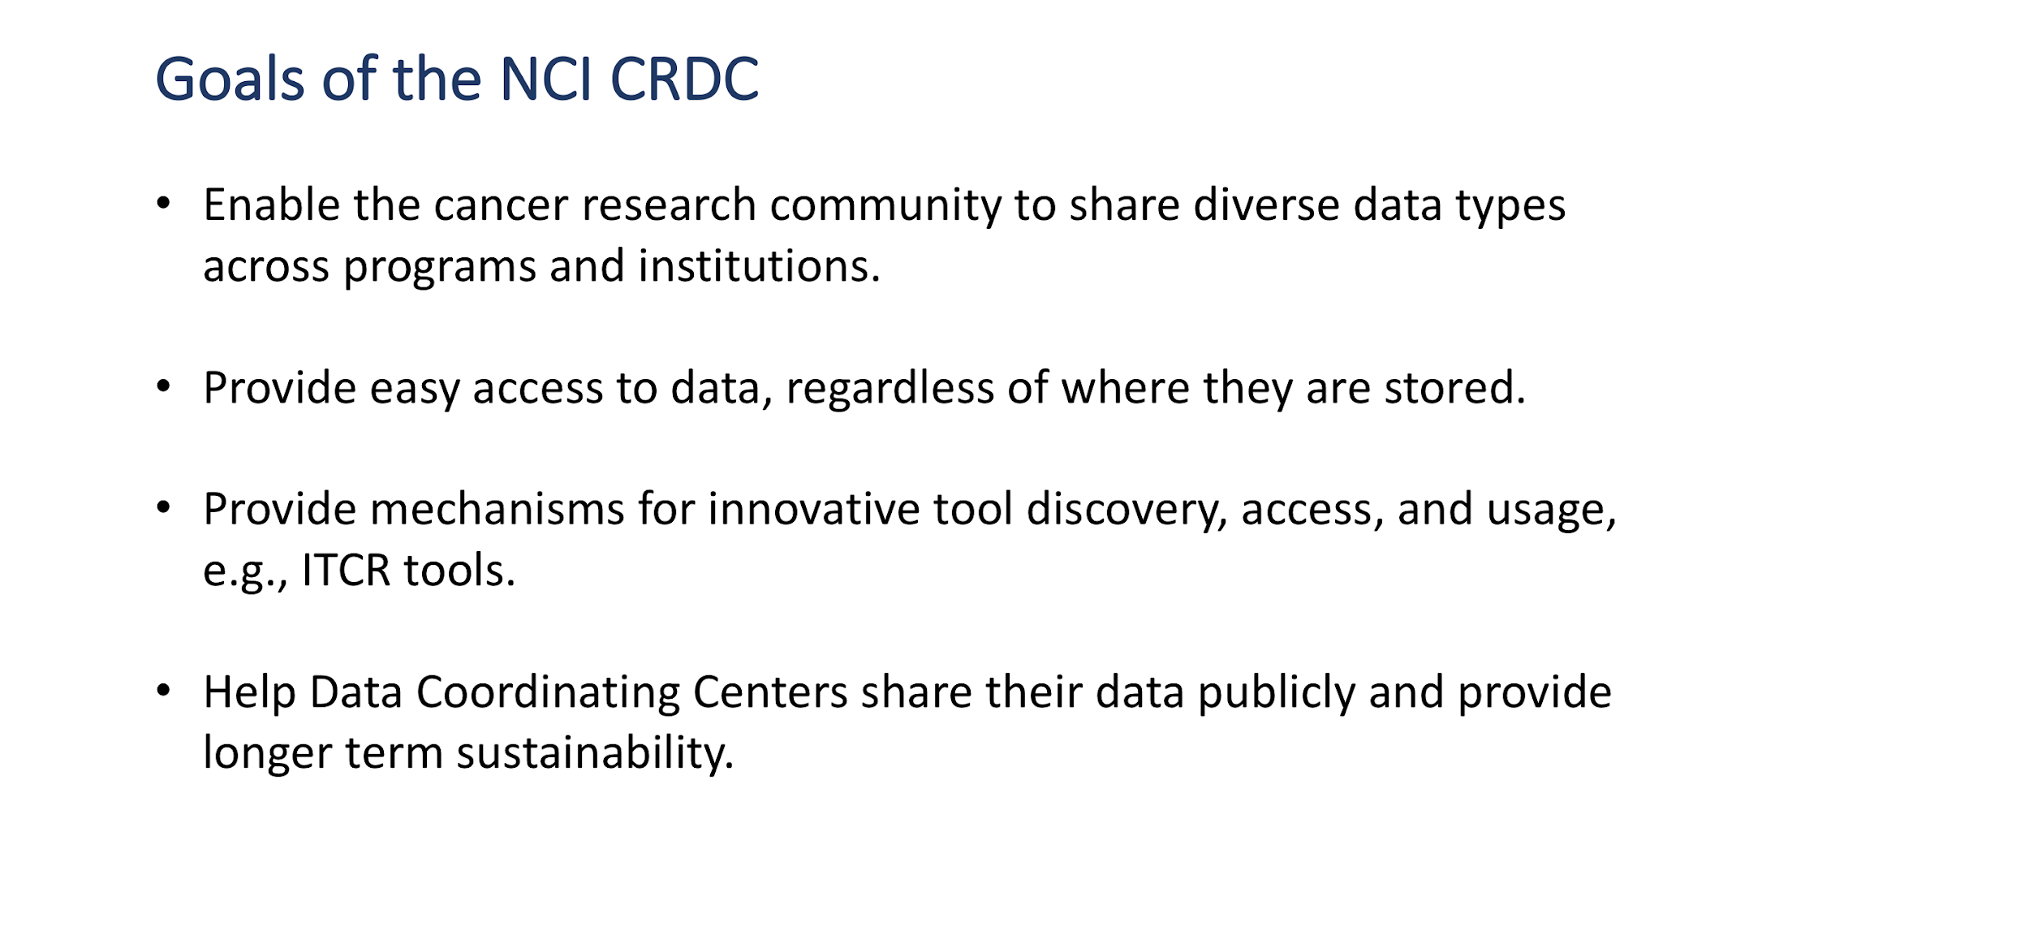

Slide 11
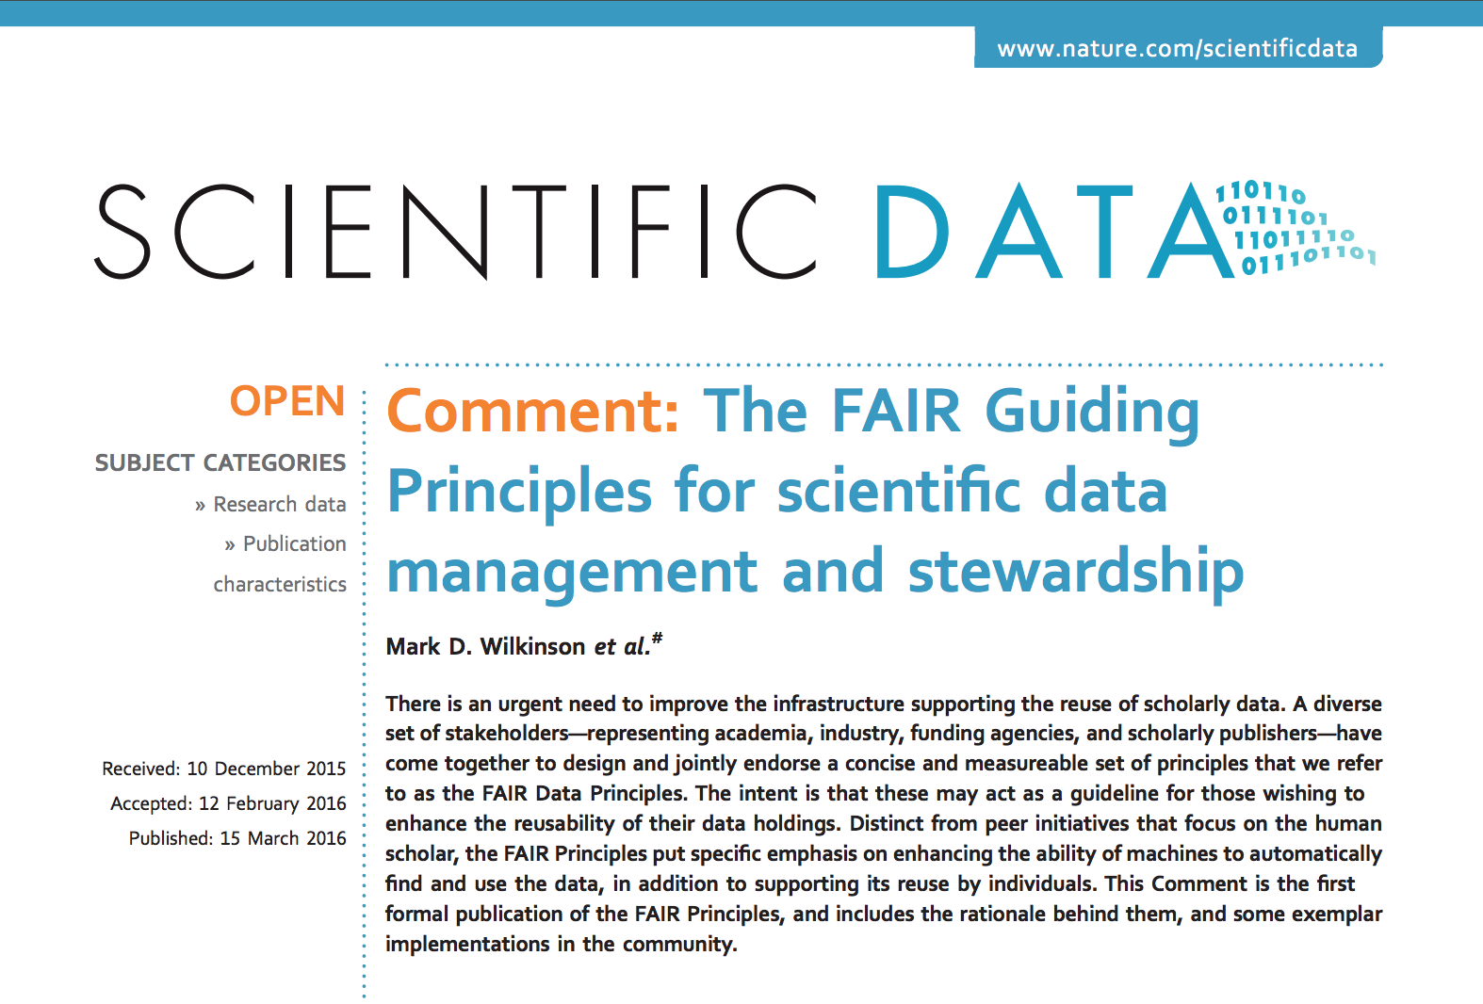
F.A.I.R Guiding Principles for Sharing Data

Slide 12
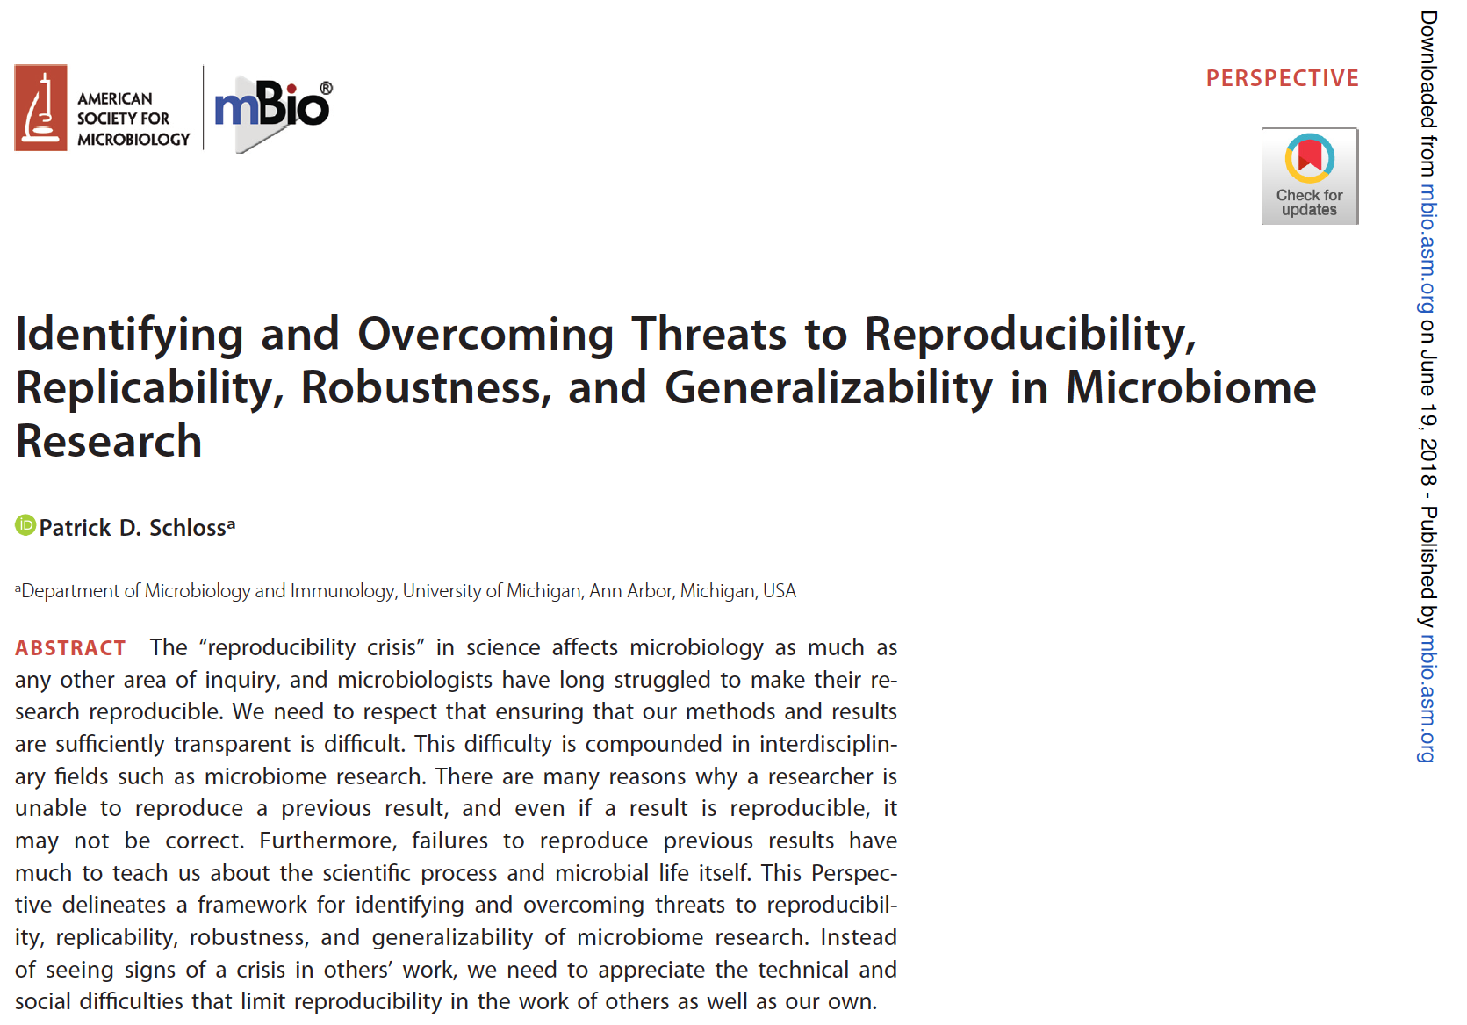
How about sharing analysis - tools and workflows?

Slide 13
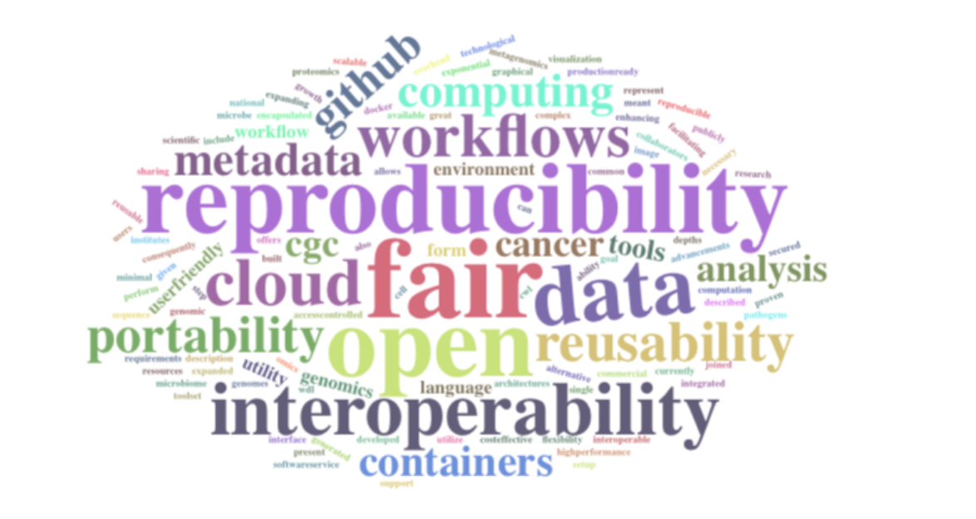
Container/workflow Technologies

Slide 14
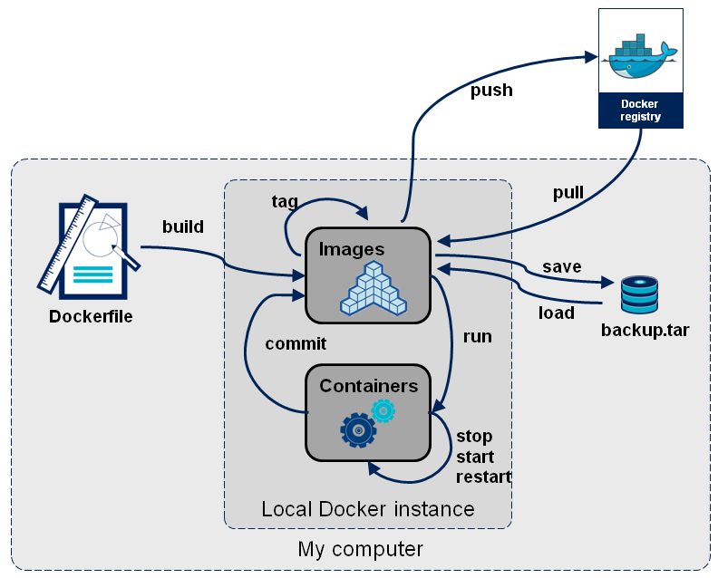

Docker
Concept
Singularity-rize
https://stackoverflow.com/questions/23735149/what-is-the-difference-between-a-docker-image-and-a-container

Slide 15
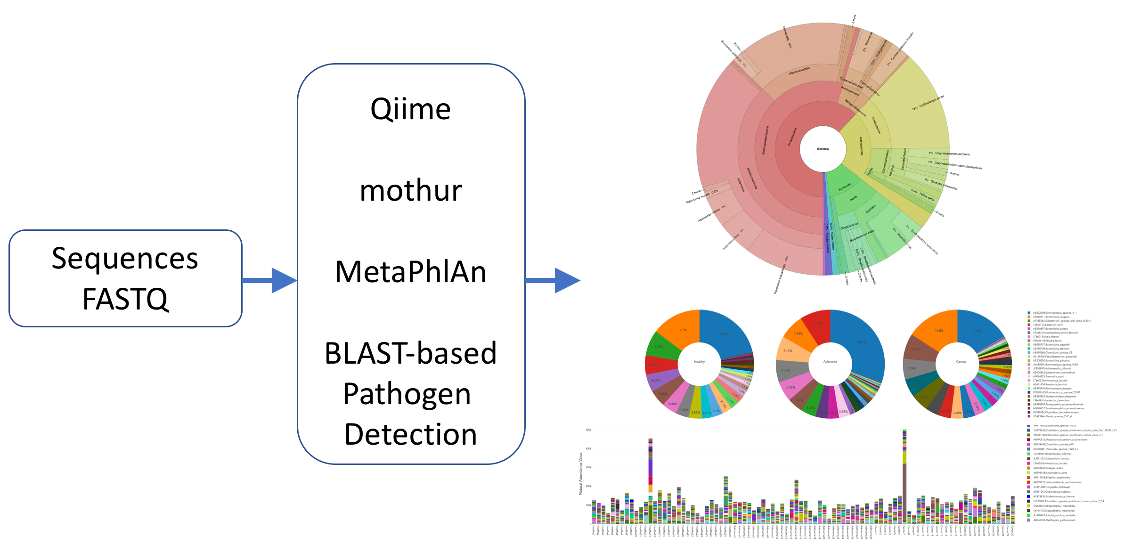
Analysis Workflows on NCI Cloud Resources
WGS, WXS
Variant
Neoantigen
Proteomics
Imaging

Slide 16
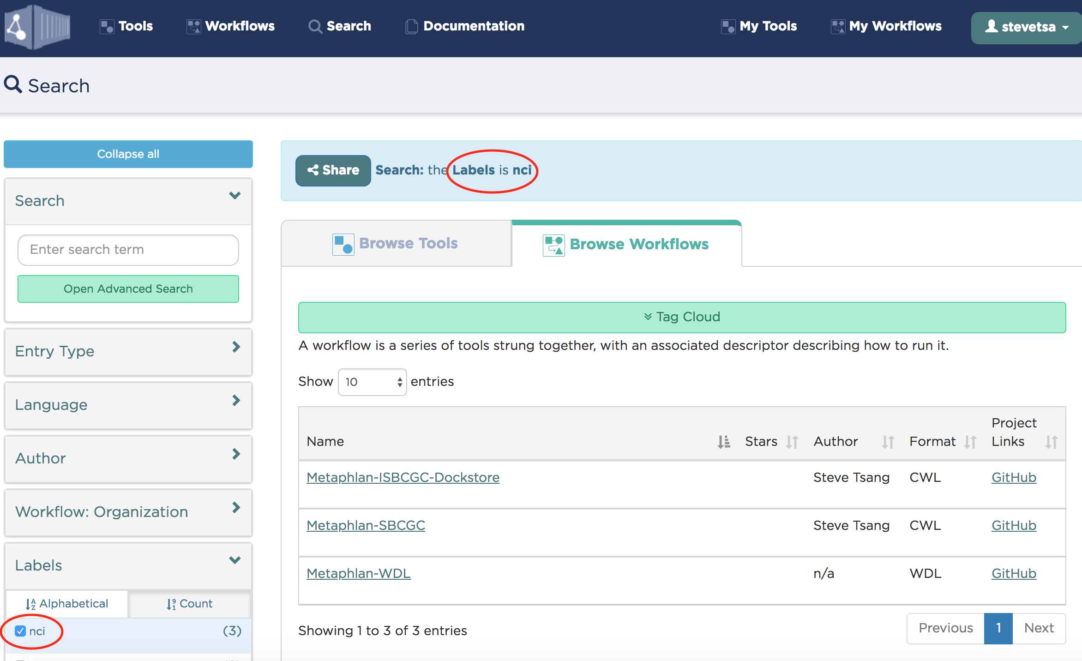
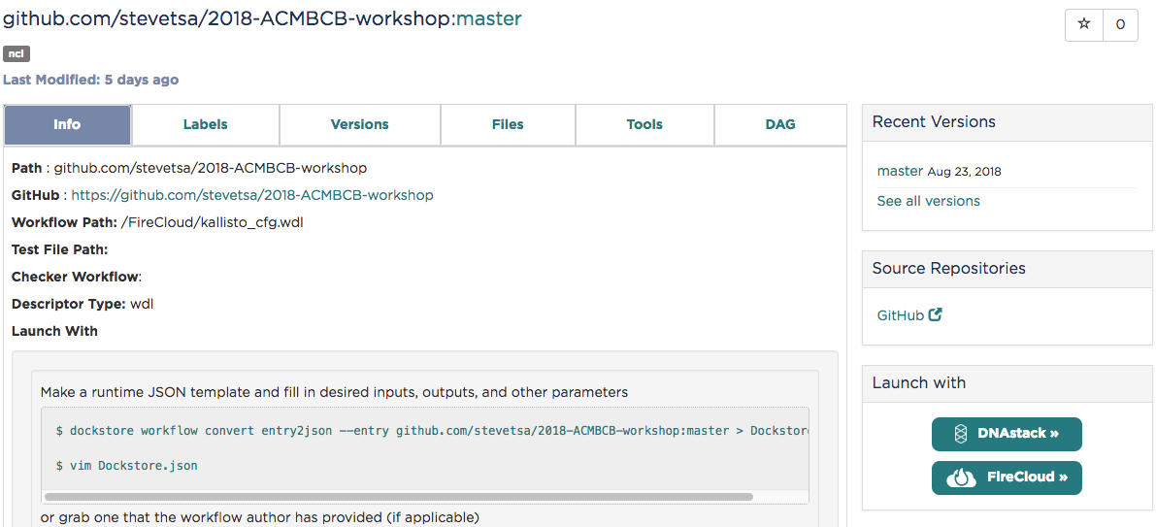
Dockstore

Slide 17
An RNA-seq Quantification Example
kallisto is a program for quantifying abundances of transcripts from RNA-Seq data, or more generally of target sequences using high-throughput sequencing reads. It is based on the novel idea of pseudoalignment for rapidly determining the compatibility of reads with targets, without the need for alignment.
Nicolas L Bray, Harold Pimentel, Páll Melsted and Lior Pachter, Near-optimal probabilistic RNA-seq quantification, Nature Biotechnology 34, 525–527 (2016), doi:10.1038/nbt.3519
https://pachterlab.github.io/kallisto/about

Slide 18
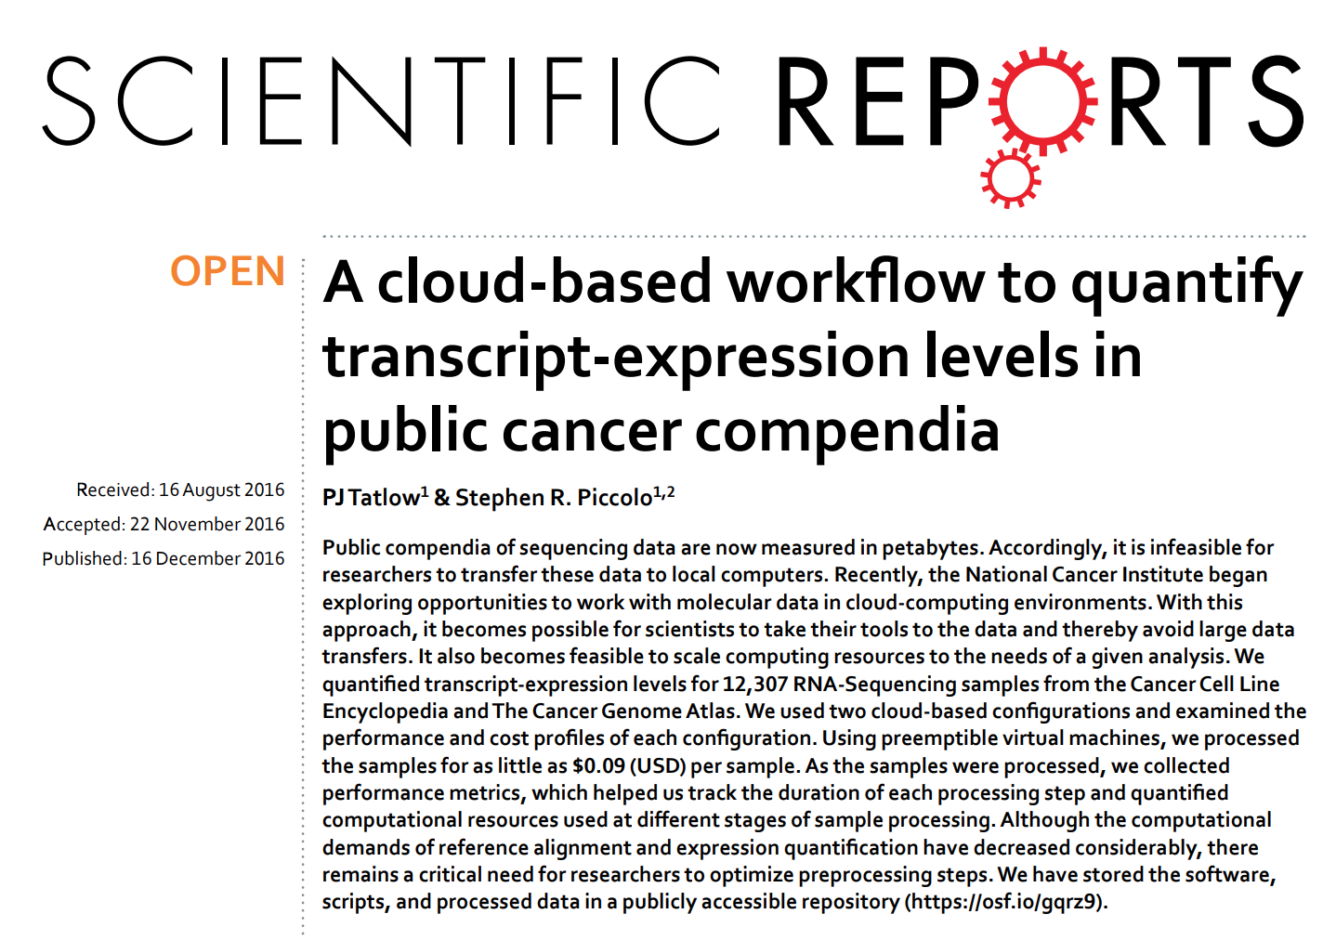

Slide 19
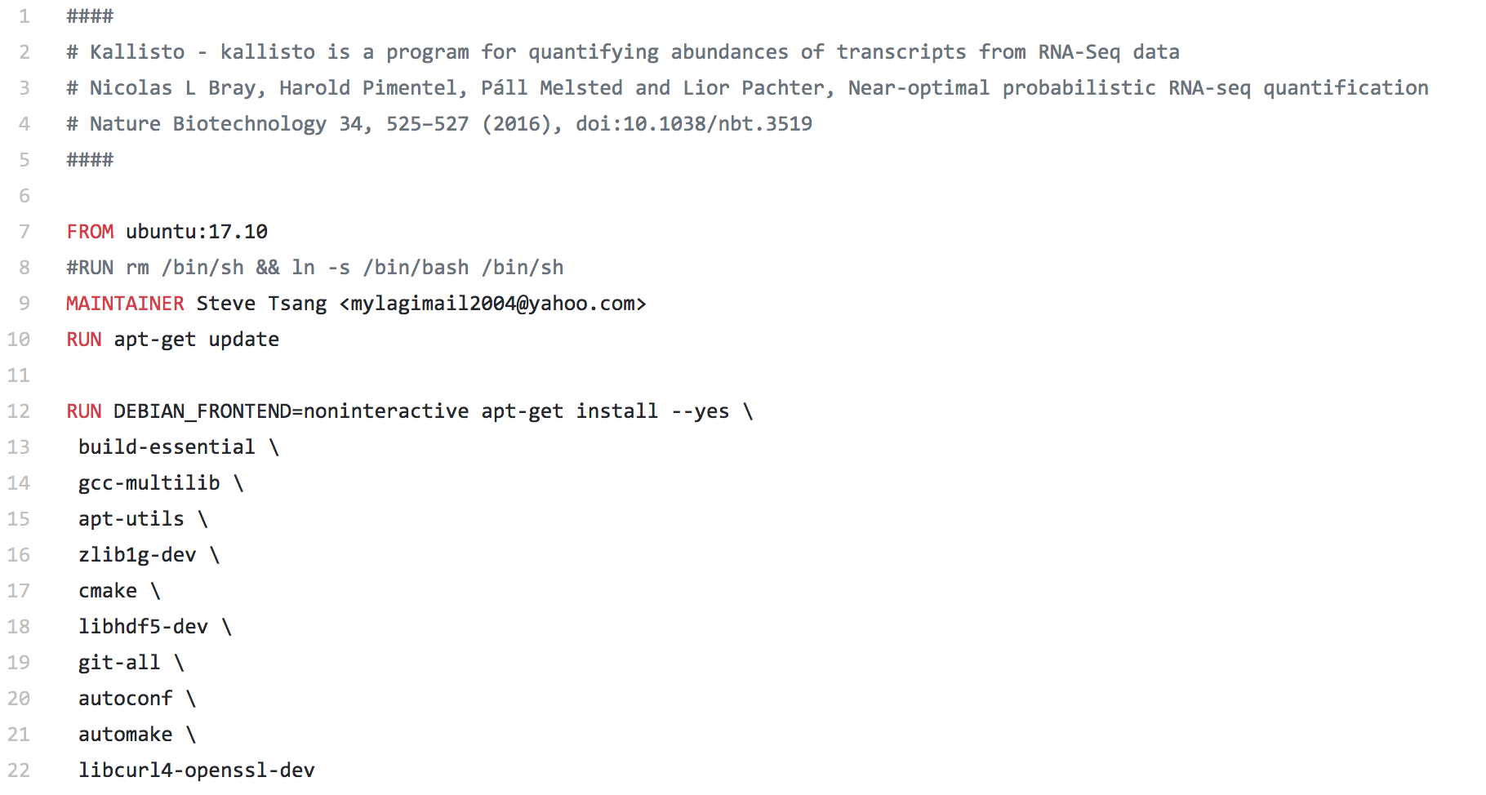
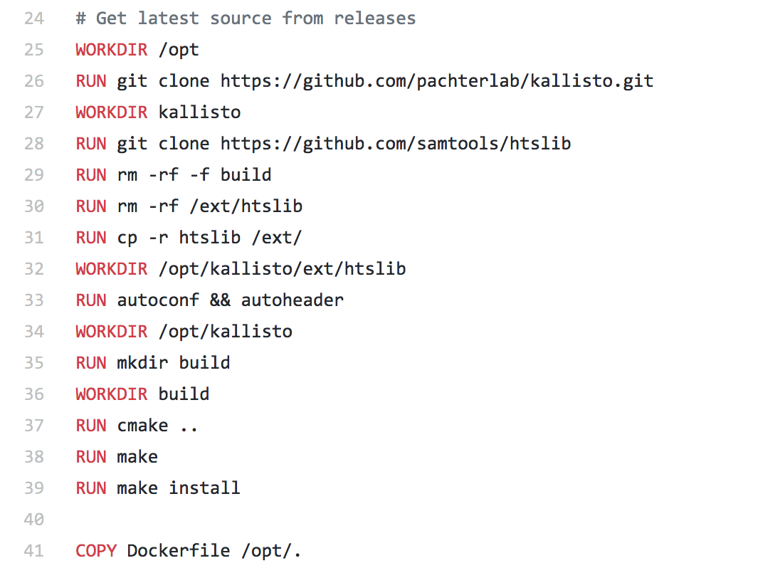
Kallisto Dockerfile
https://github.com/stevetsa/Docker-kallisto/blob/master/Dockerfile

Slide 20
Sign up for a trial!
FireCloud
$300 in credits to use on any egress, compute and storage costs accrued; credits will be available for 60 days once trial has been started
Seven Bridges CGC
$300 in credits provided upon registration for Amazon Web Services (AWS) storage and compute costs accrued on the Seven Bridges CGC
ISB-CGC
$300 free credit from Google Cloud Platform can be used towards ISB-CGC
Additional credit available for approved projects - Please contact the Cloud Resources directly for more information.

Slide 21
Account Setup
https://goo.gl/f21Lqq
NCI Cloud Resources
https://cbiit.cancer.gov/ncip/cloudresources
Access the Cloud Resources (PDF file)
https://cbiit.cancer.gov/sites/nci-cbiit/files/Access-the-CGC-Resources-v4.pdf
Broad Institute - FireCloud
http://firecloud.org
Seven Bridges Genomics - Cancer Genomics Cloud
http://www.cancergenomicscloud.org
Institute of Systems Biology - Cancer Genomics Cloud
http://isb-cgc.org

Slide 22
Break
Reconvene at 2PM
https://goo.gl/f21Lqq

Slide 23
Broad Institute’s FireCloud
https://portal.firecloud.org
Presented by Steve Tsang
https://goo.gl/f21Lqq

Slide 24
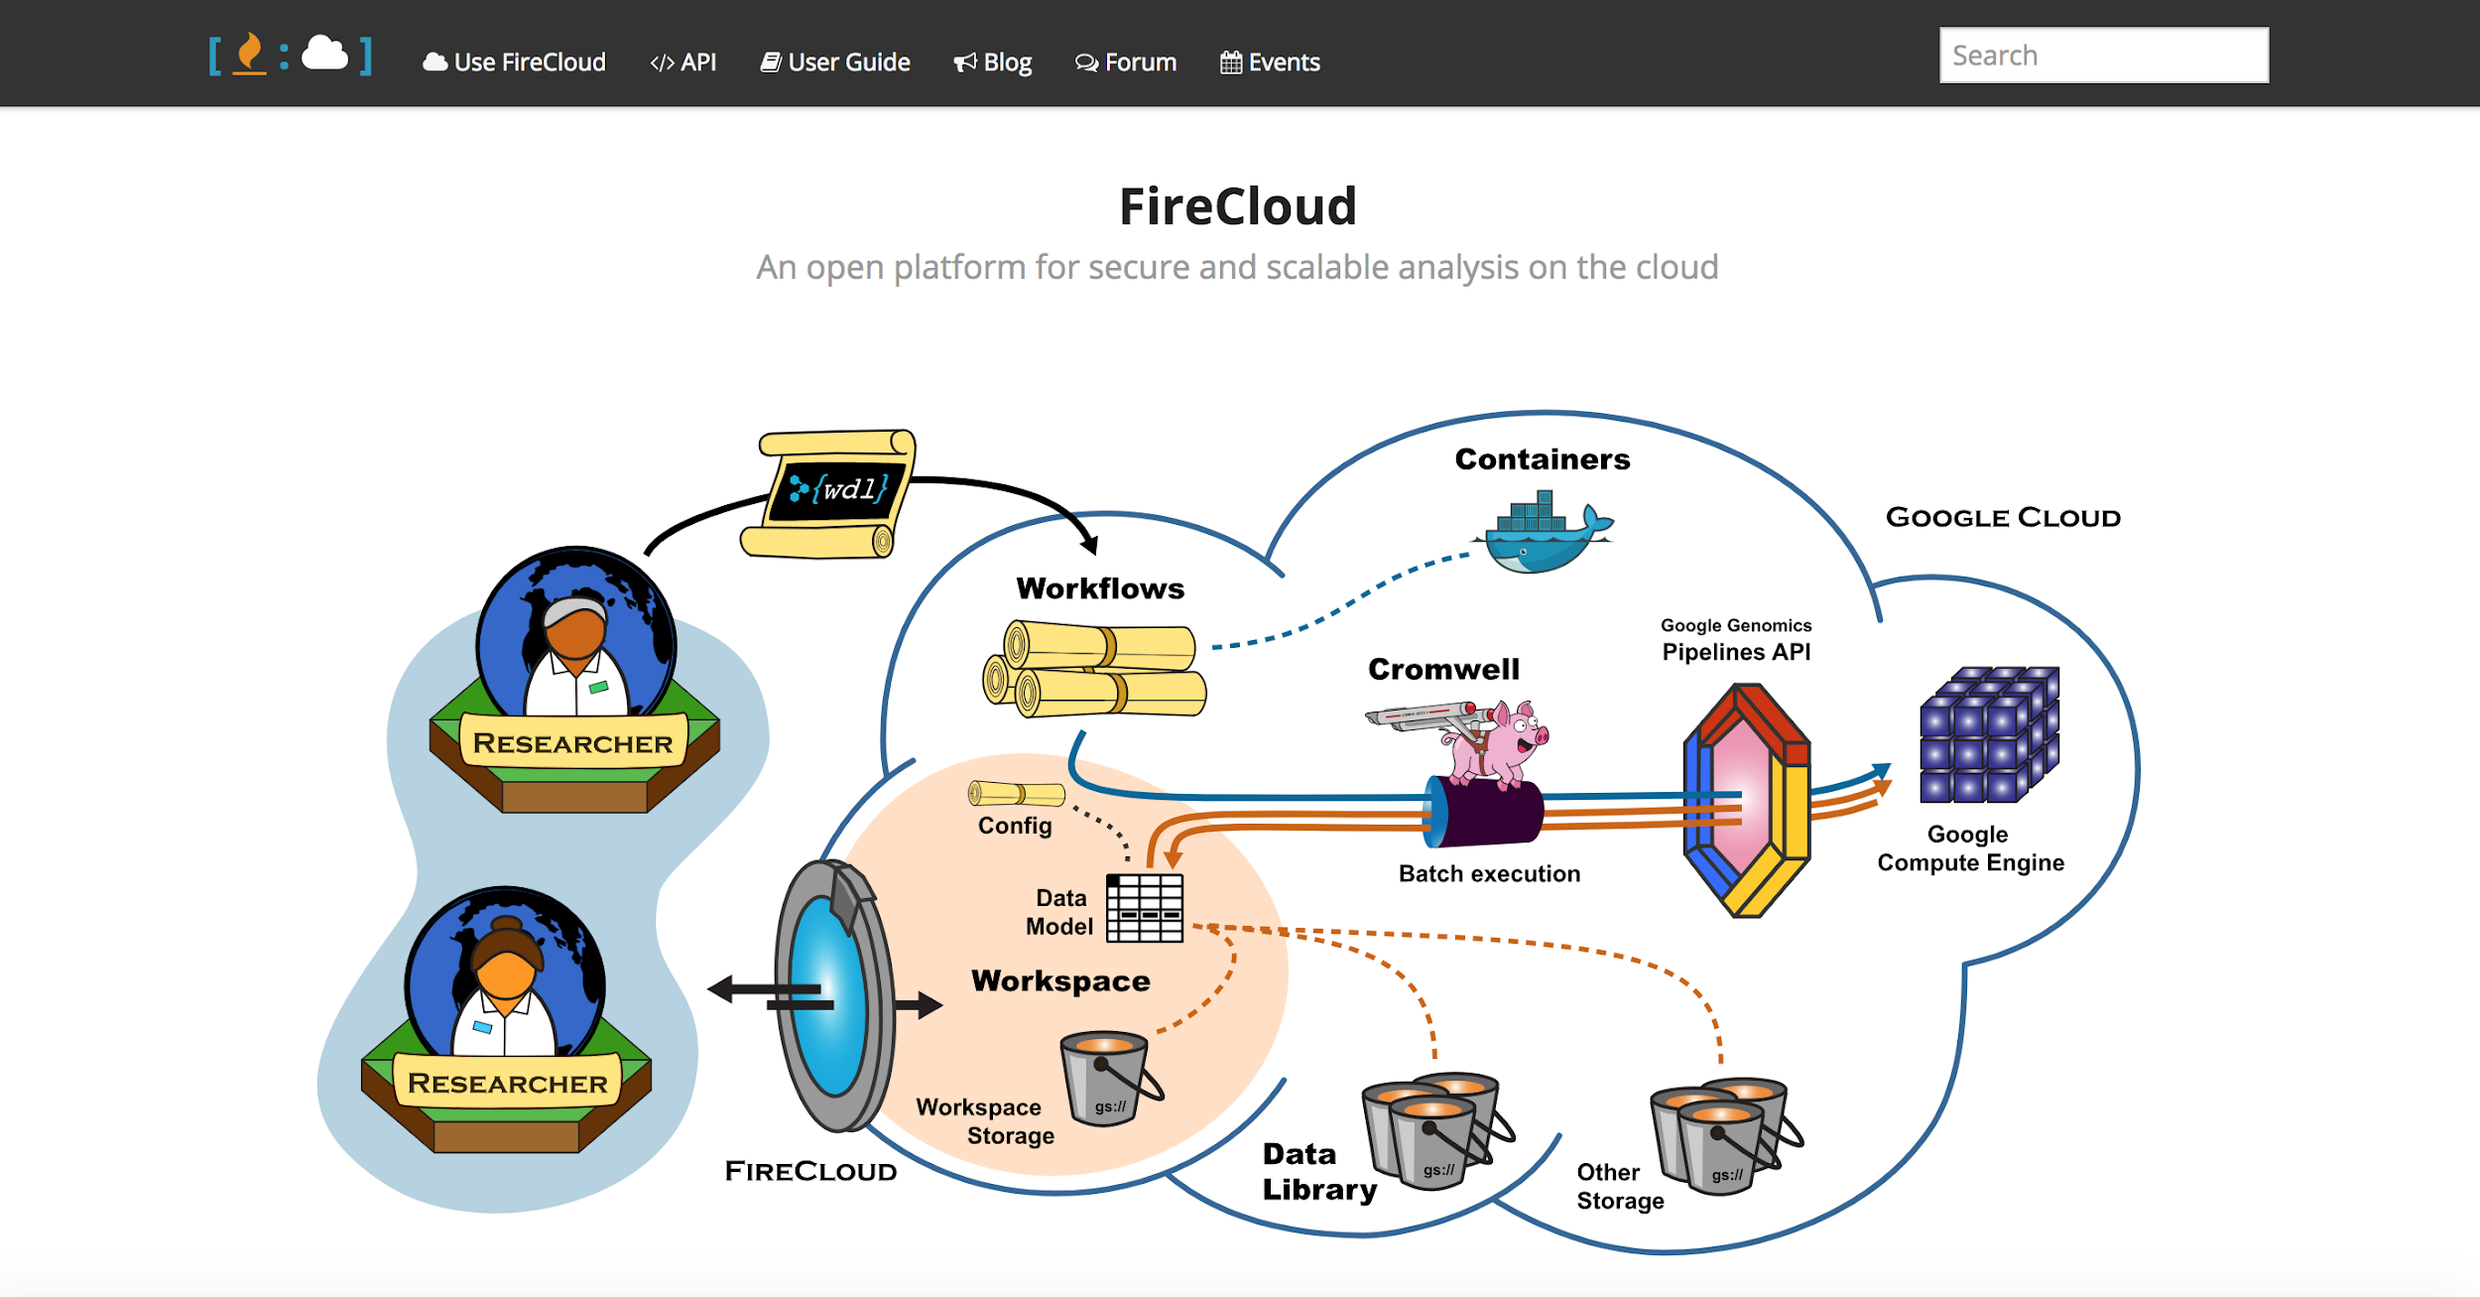
http://firecloud.org

Slide 25
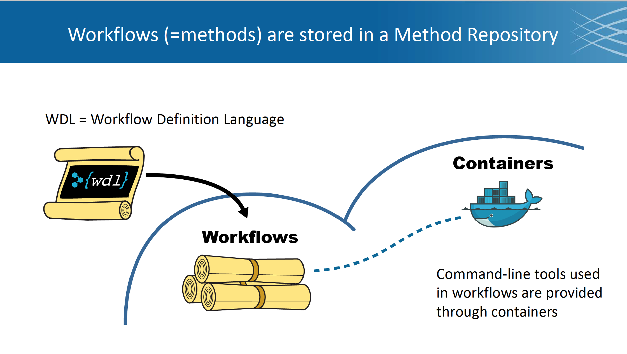

Slide 26
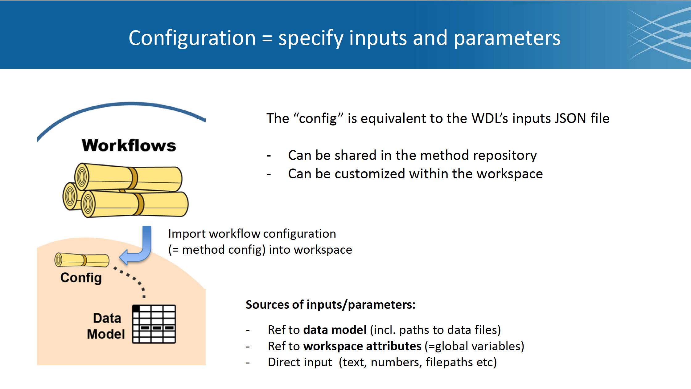

Slide 27
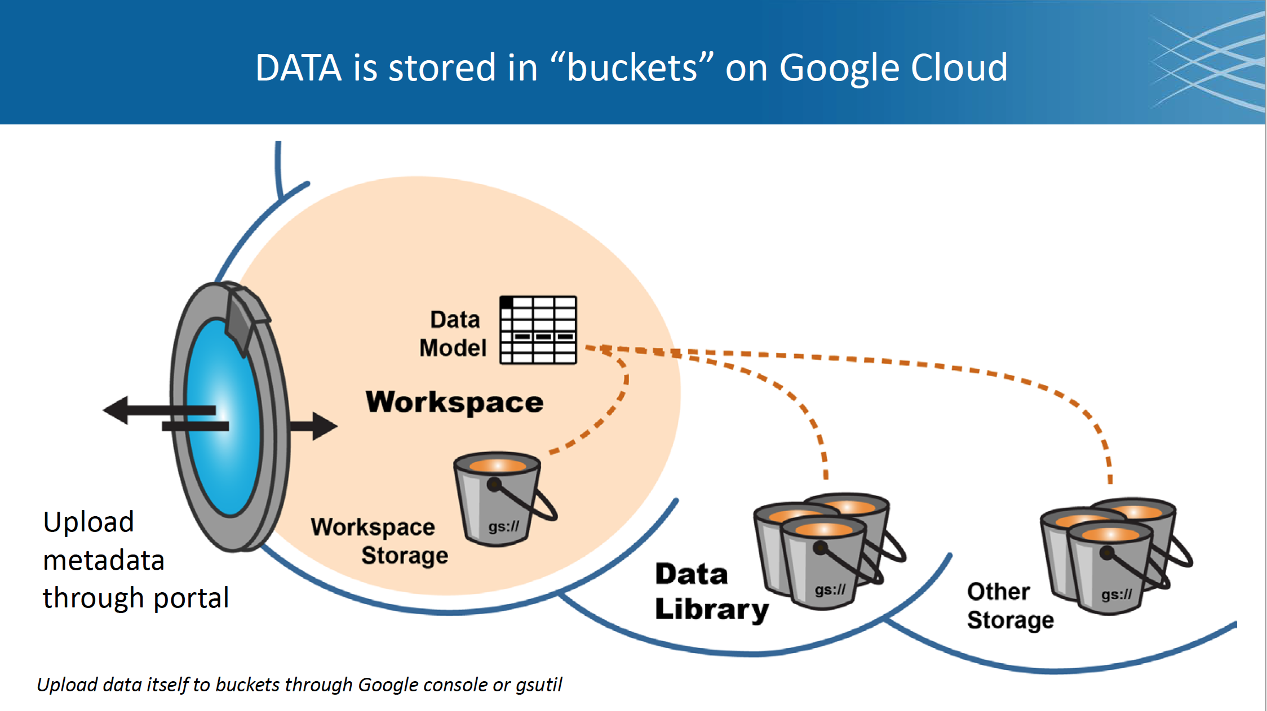

Slide 28
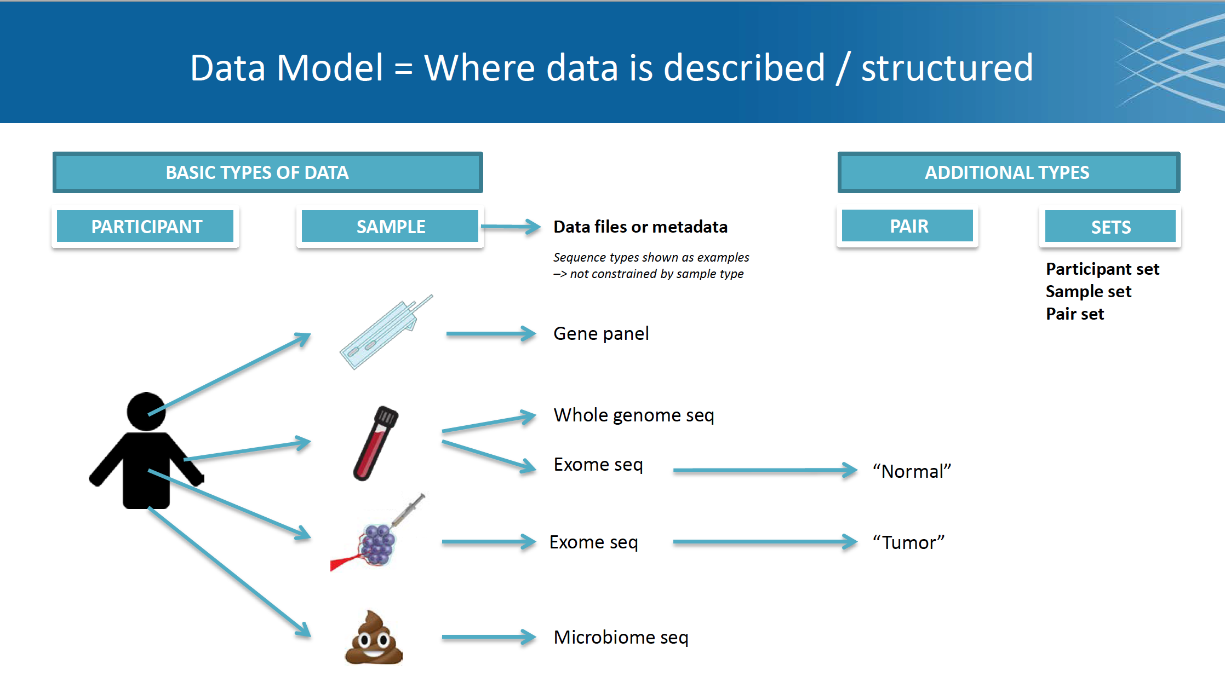
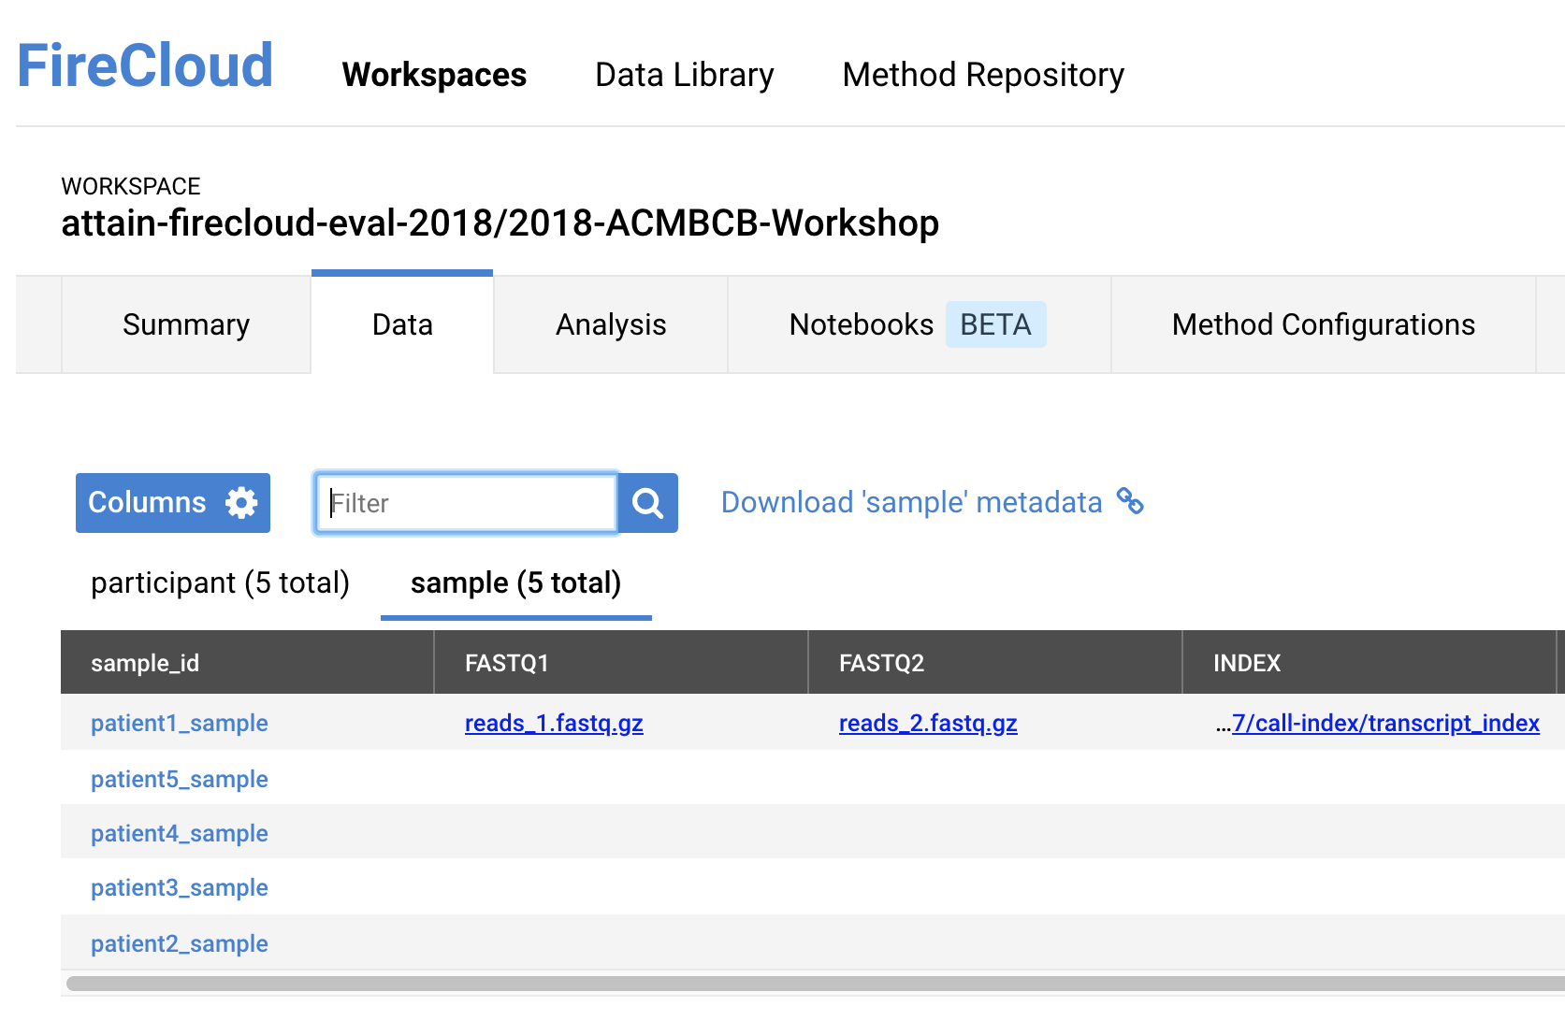

Slide 29
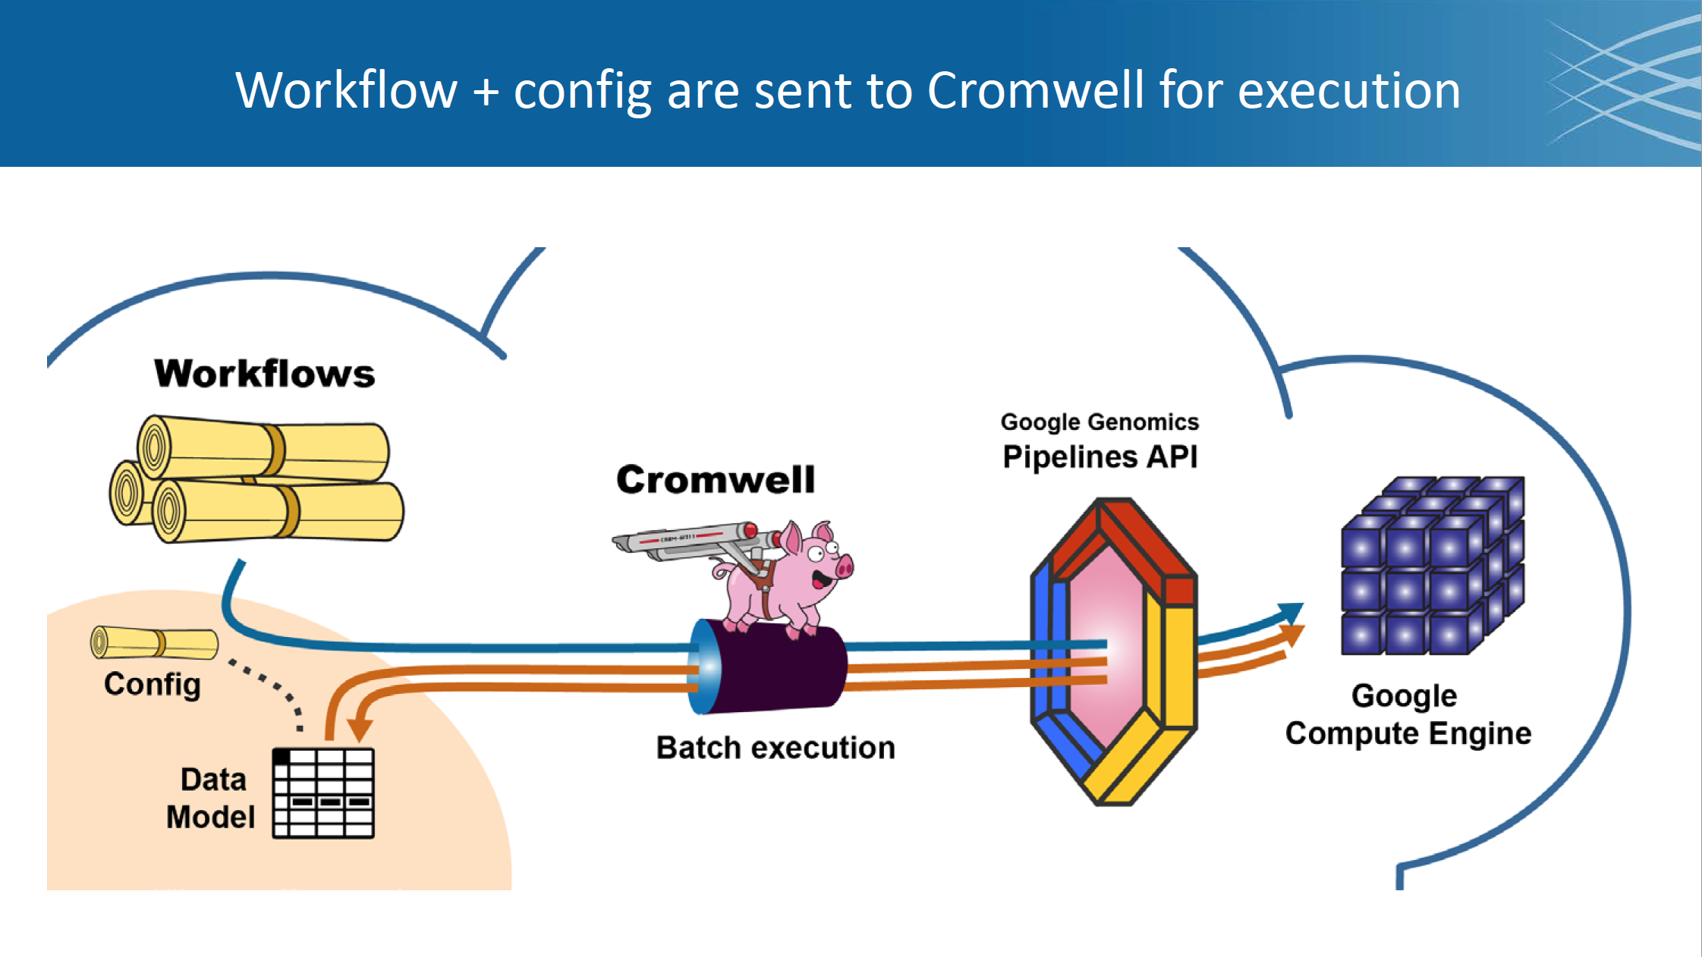

Slide 30
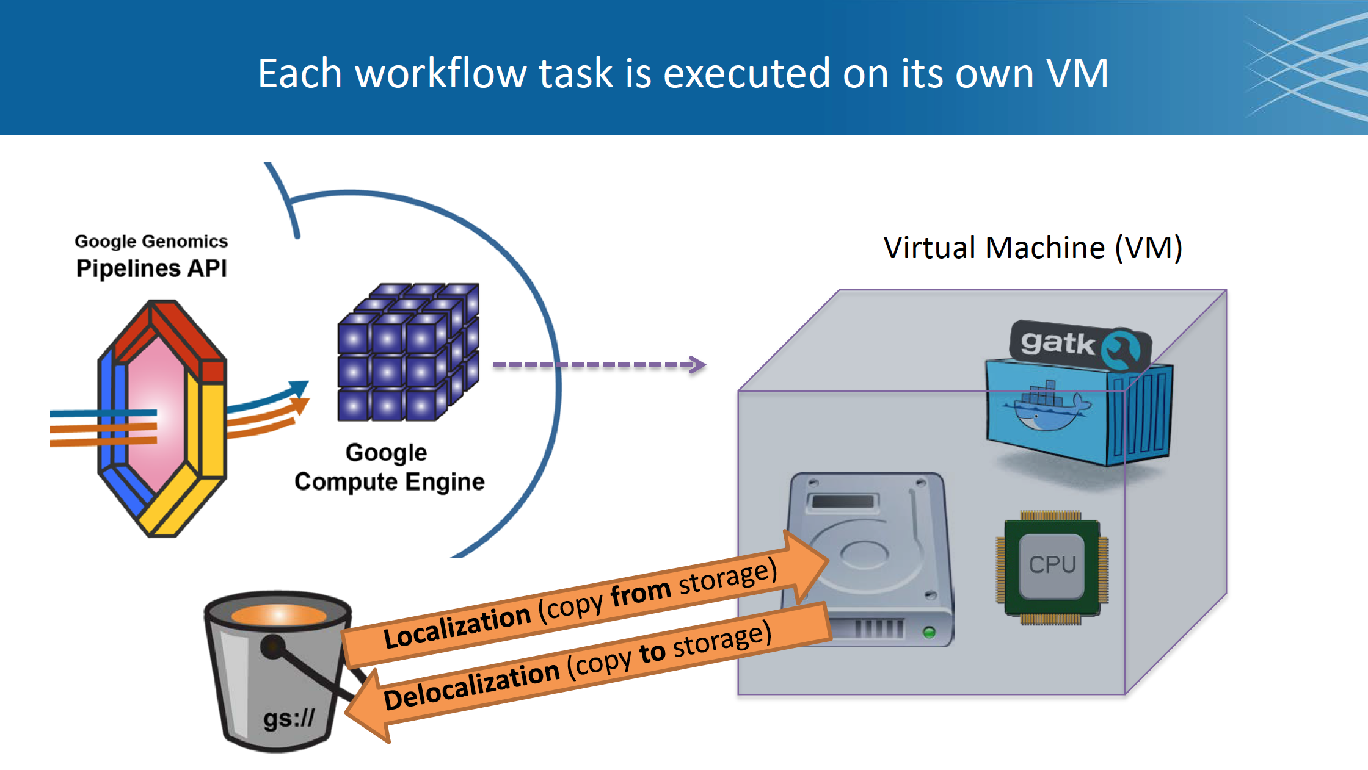

Slide 31
http://firecloud.org

Slide 32
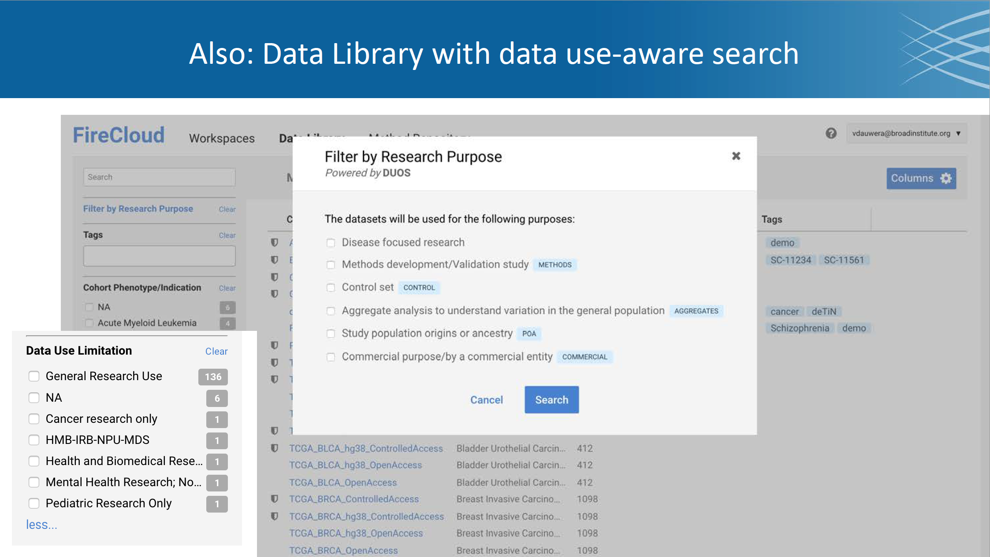

Slide 33
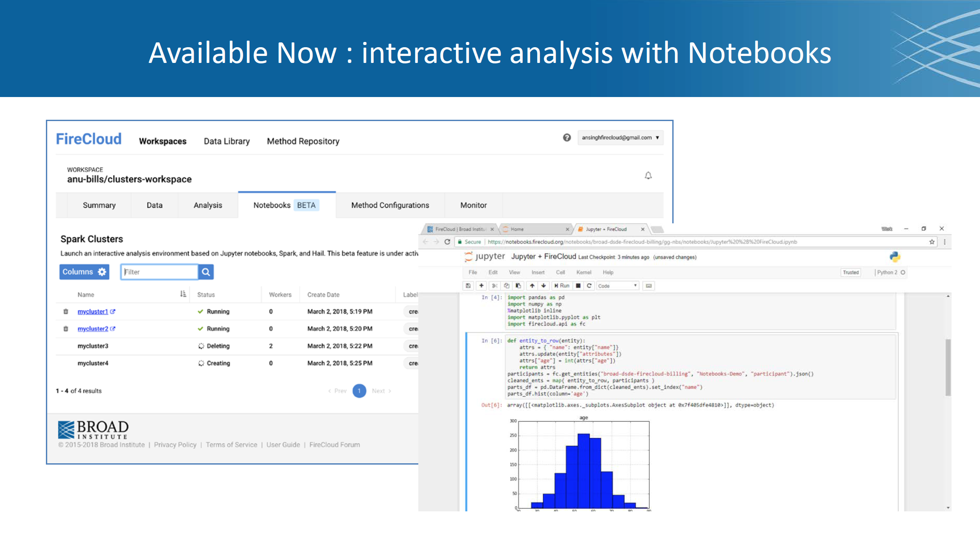

Slide 34
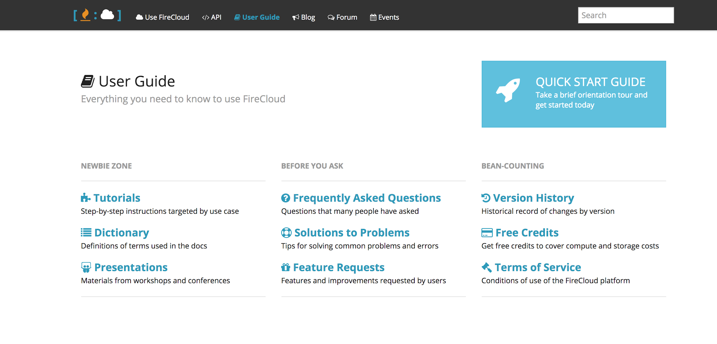
Additional Resources
https://software.broadinstitute.org/firecloud/documentation/

Slide 35
Broad Institute’s FireCloud
https://portal.firecloud.org
DEMO/Hands-on
https://goo.gl/f21Lqq

Slide 36
Break
Reconvene at 3PM
https://goo.gl/f21Lqq

Slide 37
Seven Bridges
Cancer Genomics Cloud
www.cancergenomicscloud.org
Presenter: Durga Addepalli
https://goo.gl/f21Lqq

Slide 38
Introduction to the
Seven Bridges Cancer Genomics Cloud
SAMPLE TITLE
HERE
cancergenomicscloud.org

Slide 39


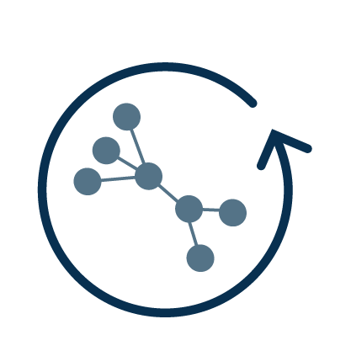
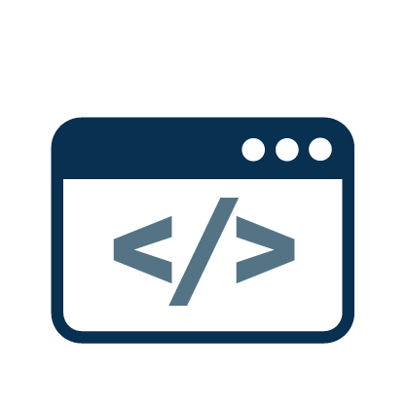
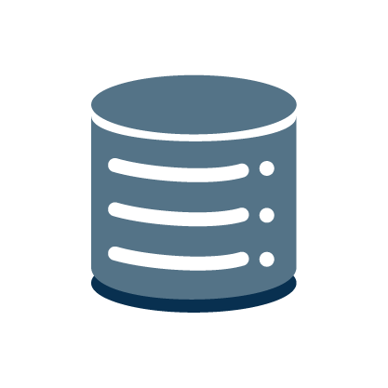


The Seven Bridges Cancer Genomics Cloud (CGC)
A user-friendly, web-based portal for collaborative analysis of petabytes of multi-omic data alongside private data
Used to date by 3,600⁺ researchers to log a cumulative 785⁺ years of compute time
User-friendly interface
Secure, global collaboration
Easy data management
Flexible & reproducible bioinformatics
Scalable computation
Developer-
friendly
platform
The Seven Bridges Cancer Genomics Cloud has been funded in whole or in part with Federal funds from the National Cancer Institute, National Institutes of Health, Contract No. HHSN261201400008C and ID/IQ Agreement No. 17X146 under Contract No. HHSN261201500003I.

Slide 40
Overview
Available immediately and at no cost to any non-commercial researcher or bioinformatics tool developer
Easy to use through an intuitive web interface and powerful APIs
Provides easy access to:
customizable workspaces for secure, global collaboration
3 PB of public multi-omic datasets
tools for uploading or remotely accessing private data
350⁺ cloud- and cost-optimized bioinformatics tools and workflows
a software development kit (Rabix) for developing custom bioinformatics tools
a JupyterLab environment (Data Cruncher) for custom scripting
Supported by a team of 150+ expert bioinformaticians, tool developers, and engineers

Slide 41
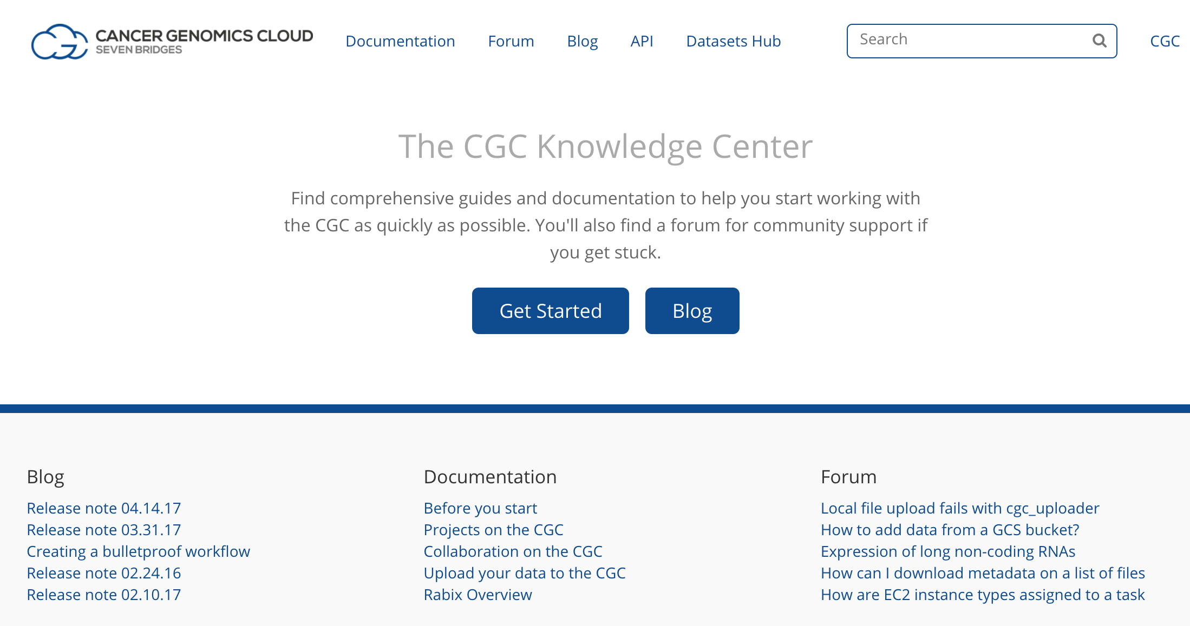
Accessible Technical Resources & Support
Documentation
Training resources
Q&A forum
Release notes
docs.cancergenomicscloud.org

Slide 42
Key Features

Slide 43
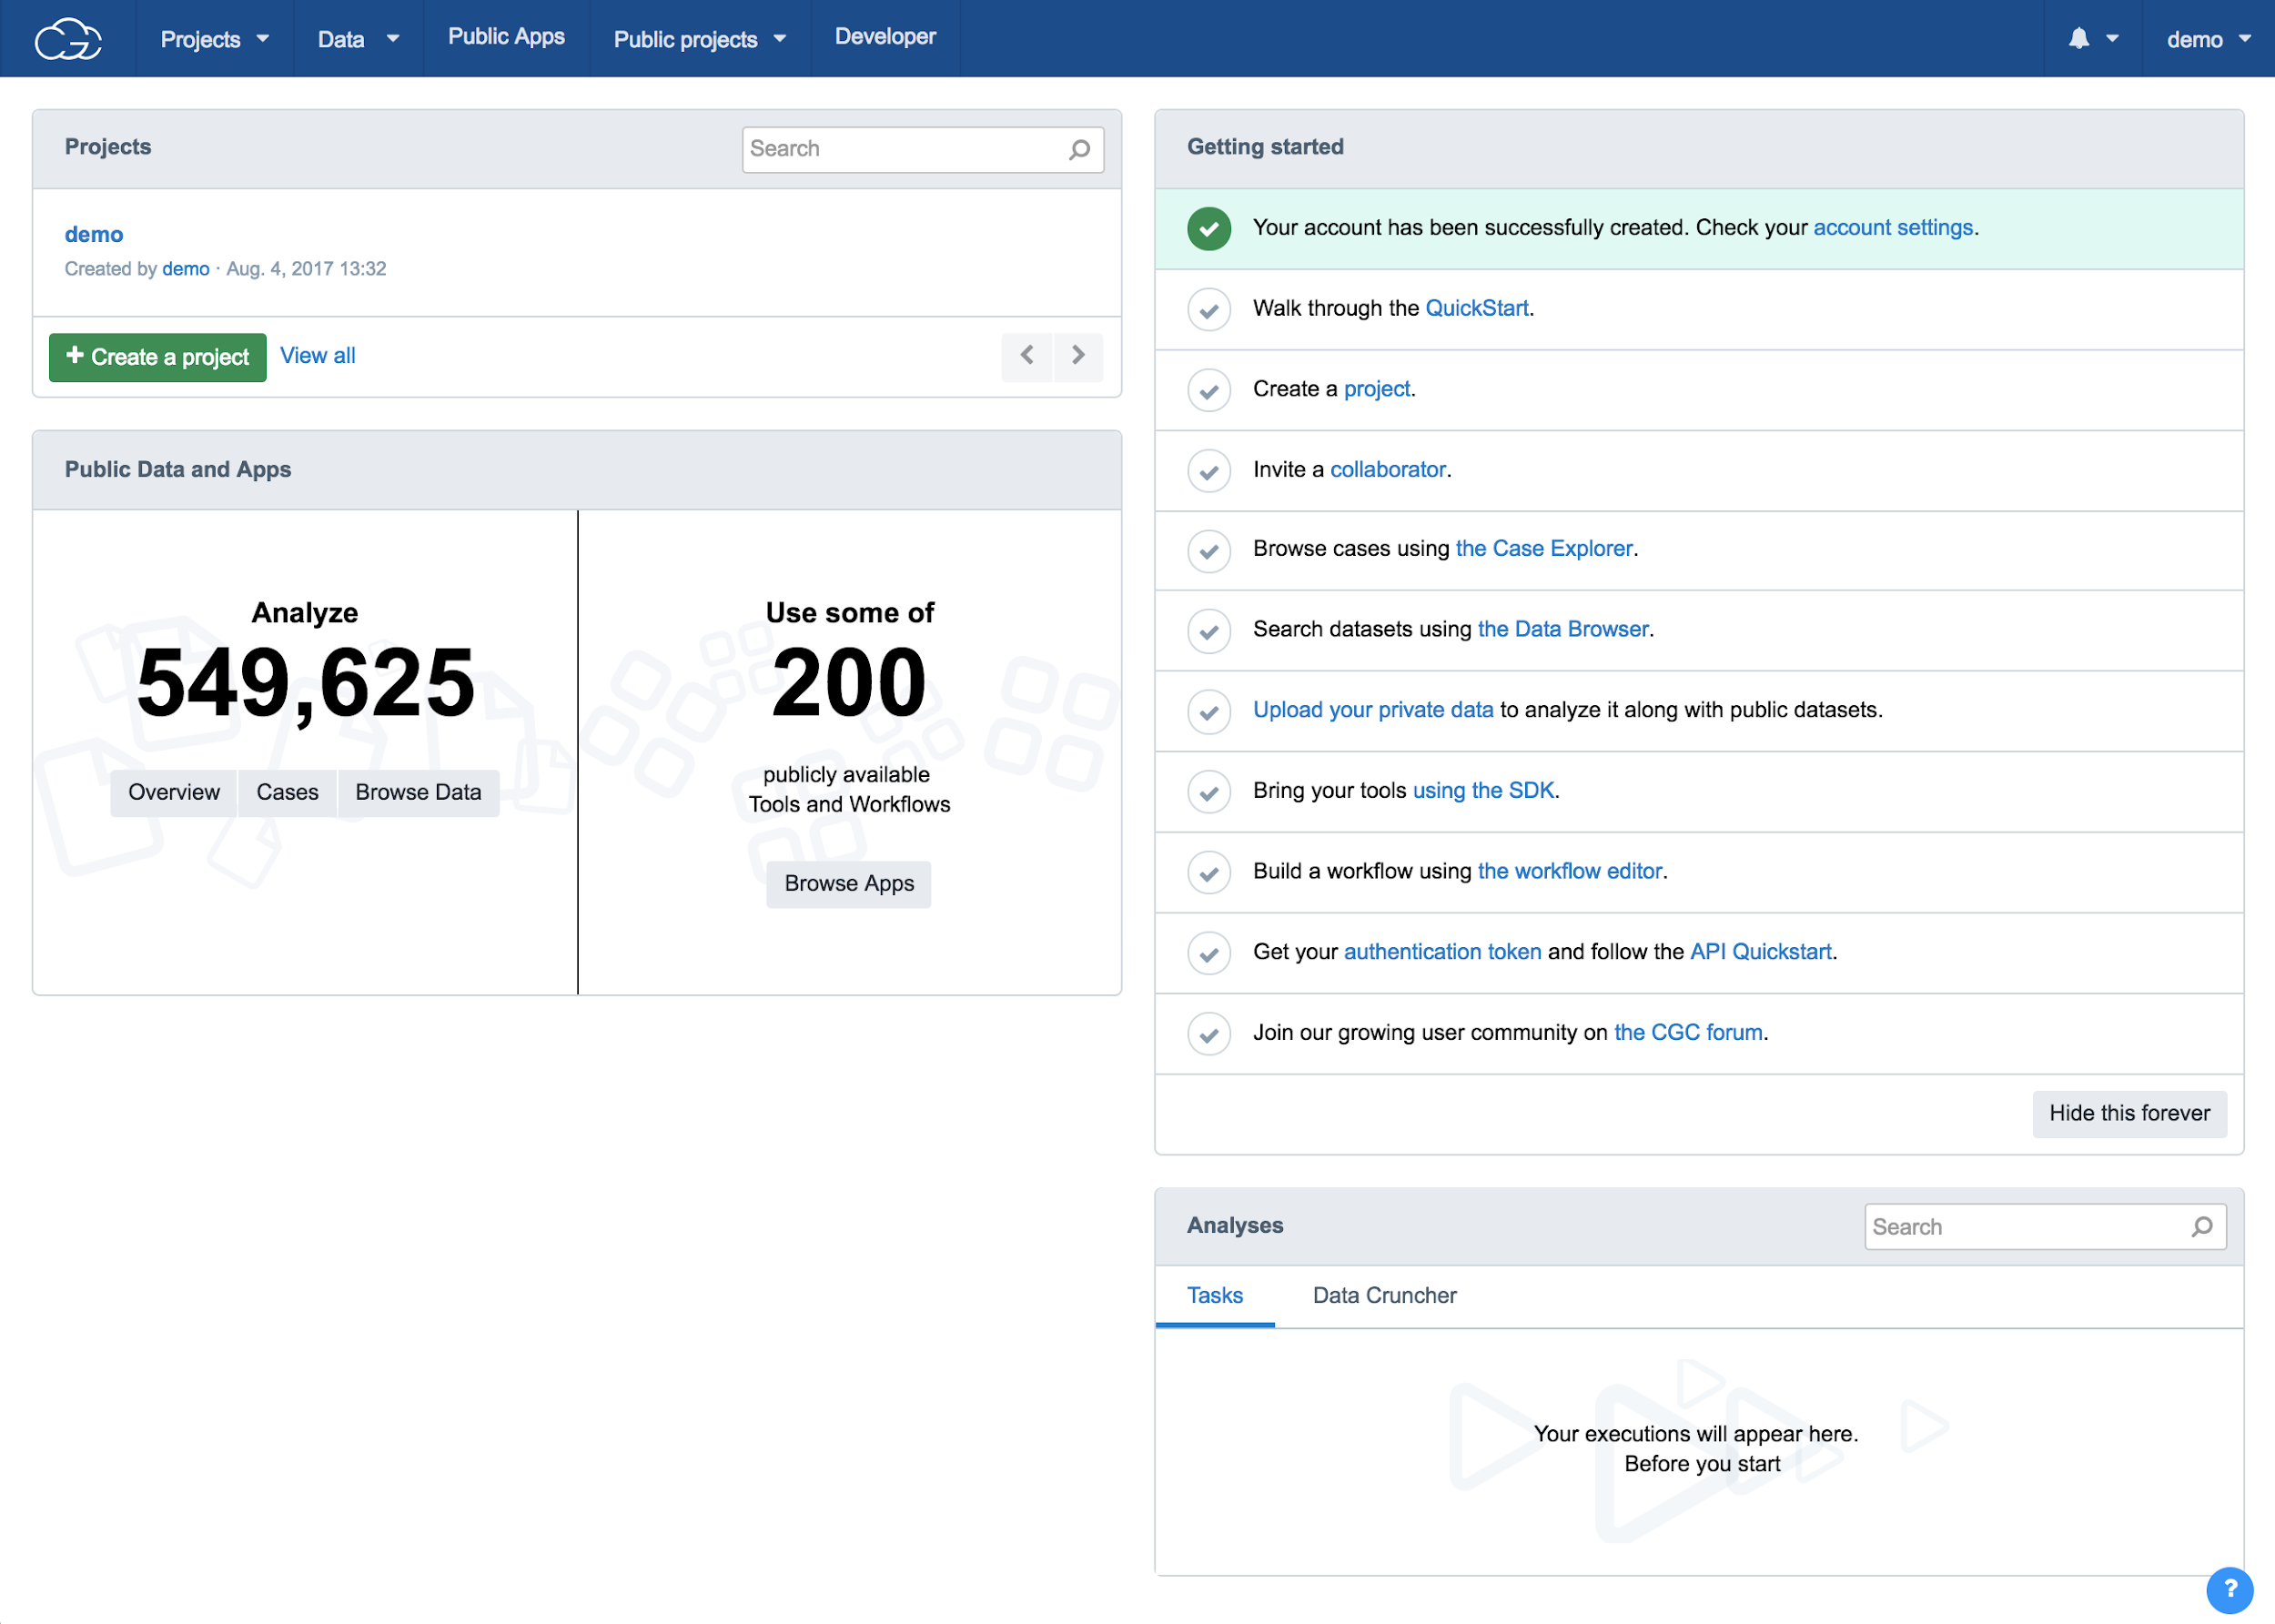
User-friendly Web Interface
Easy access to CGC tools & resources, including a personalized dashboard to organize your research
Projects: a searchable index of a user’s private workspaces
Data: links to tools for querying public datasets & accessing private data
Public Apps: a searchable, curated gallery of tools & workflows
Public Projects: a collection of demo projects highlighting specific public datasets and tools
Developer: links to resources for programmatic access & custom tool development

Slide 44
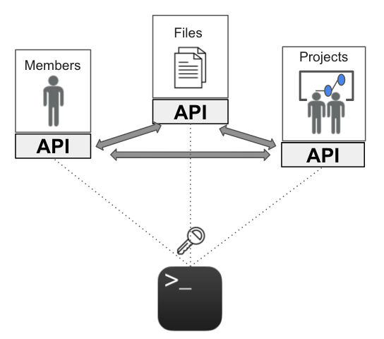



Tools for Programmatic Access
Powerful RESTful API
Datasets API for metadata queries
Object-oriented and user-friendly libraries in Python, R, & Java
…

Slide 45
Tools for Programmatic Access (continued)
sevenbridges-r:
An R/Bioconductor package offering easy, programmatic access to the CGC
Complete R API client for organizing your files, projects, tasks & project members
A CWL scripting interface for creating tools by writing R functions
A helper for automated cloud task monitoring & batch task creation in R
A bridge for connecting R & open source communities to the CGC
Github - sevenbridges
https://sbg.github.io/sevenbridges-r/
Github - teamcgc + cgcR + vignettes
https://github.com/teamcgc/cgcR/blob/master/vignettes/SBCGC-R-Overview-RNASeqWf-Batch.Rmd

Slide 46
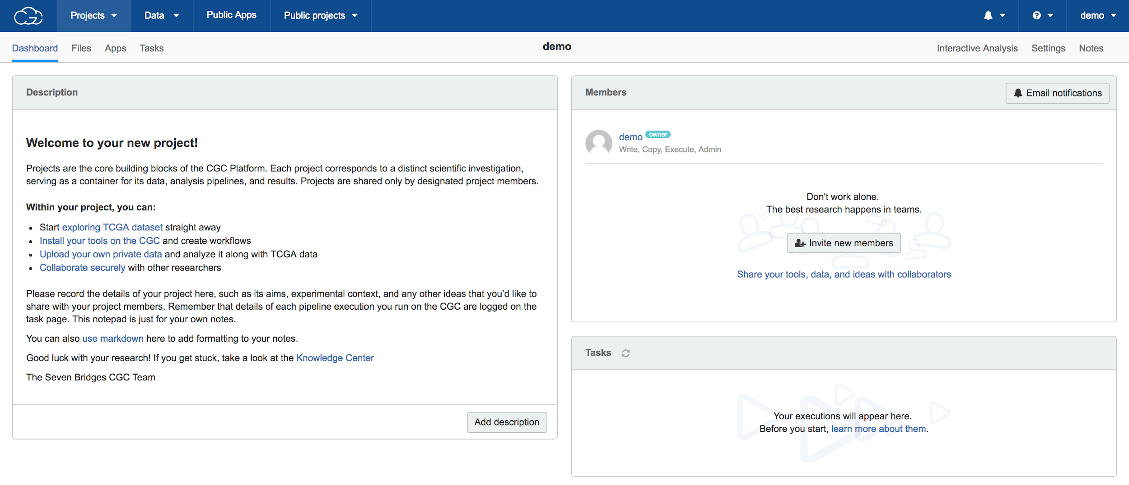
Research Management Tools
Projects: Secure & customizable private workspaces for the management of:
Files (input & output data)
Apps (tools & workflows)
Tasks (computation runs)
Members (collaborators)
Automatically generated, durable records of input/output files and app versions & parameters for every task

Slide 47
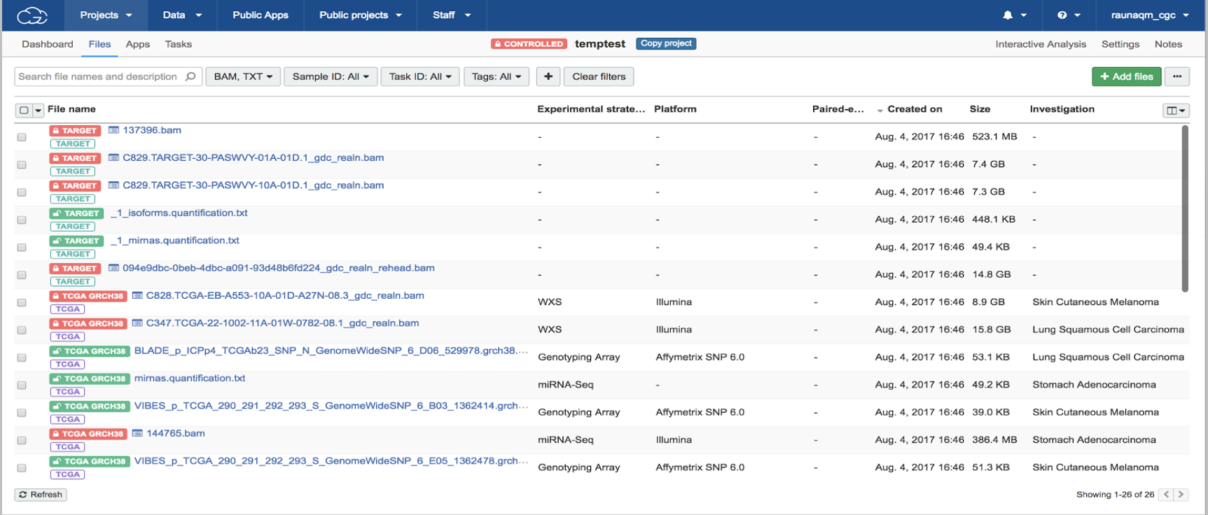
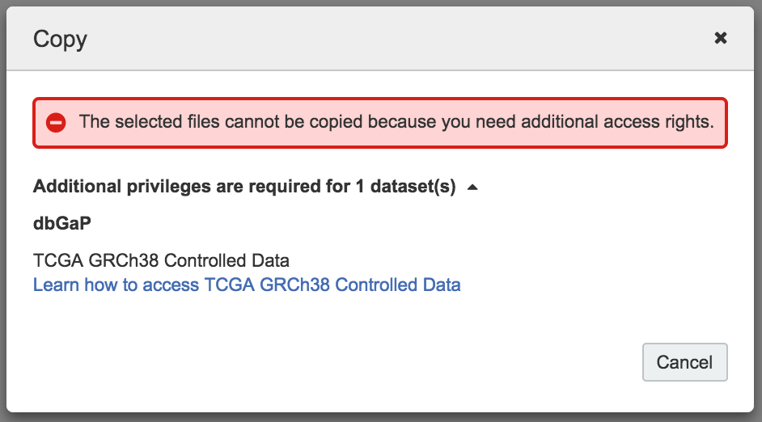
Data Security Tools
Per-file, per-user permissions management for controlled-access data (Controlled Data) that help users keep data secure
Standard projects: Workspaces for open-access data (Open Data). Any CGC user can be invited as a Member.
Controlled Projects: Restricted-access workspaces for Controlled Data. Only CGC users with approval from dbGaP or ICGC to access Controlled Data can be invited as a Member.

Slide 48
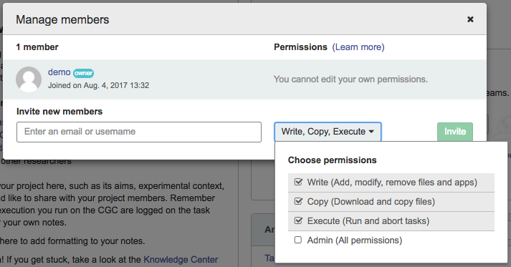
Collaboration Tools
Customizable permissions for each project Member
Customizable project Description, Notes, and Email notifications for communicating with collaborators in real time around the world

Slide 49





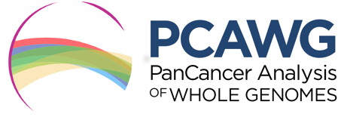
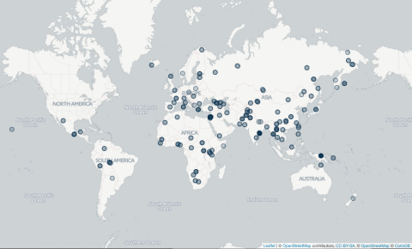

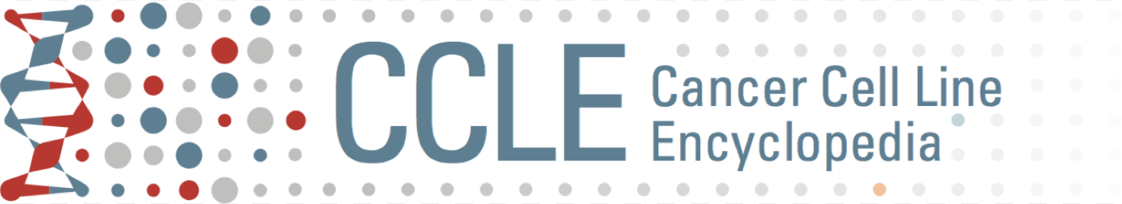
3 Petabytes of Multi-Omic Public Data

Slide 50
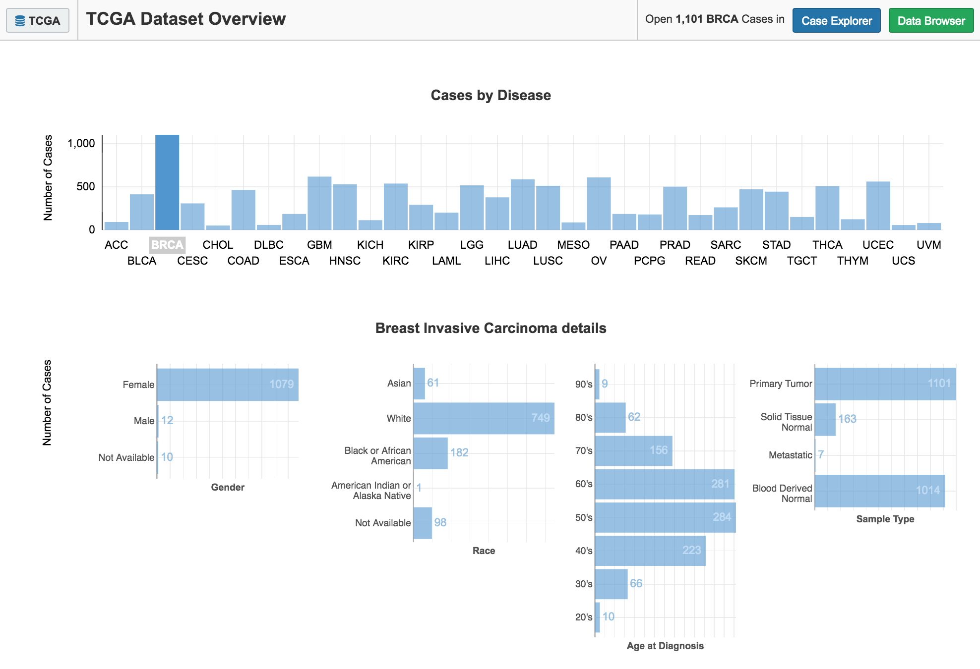
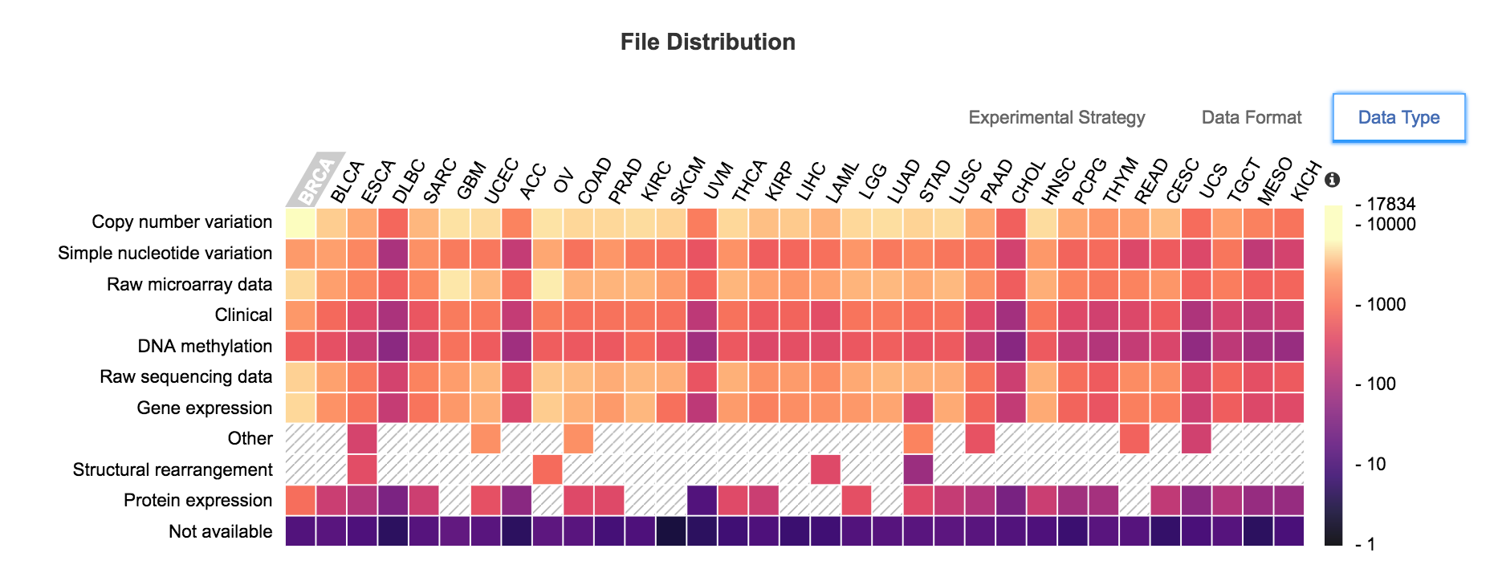
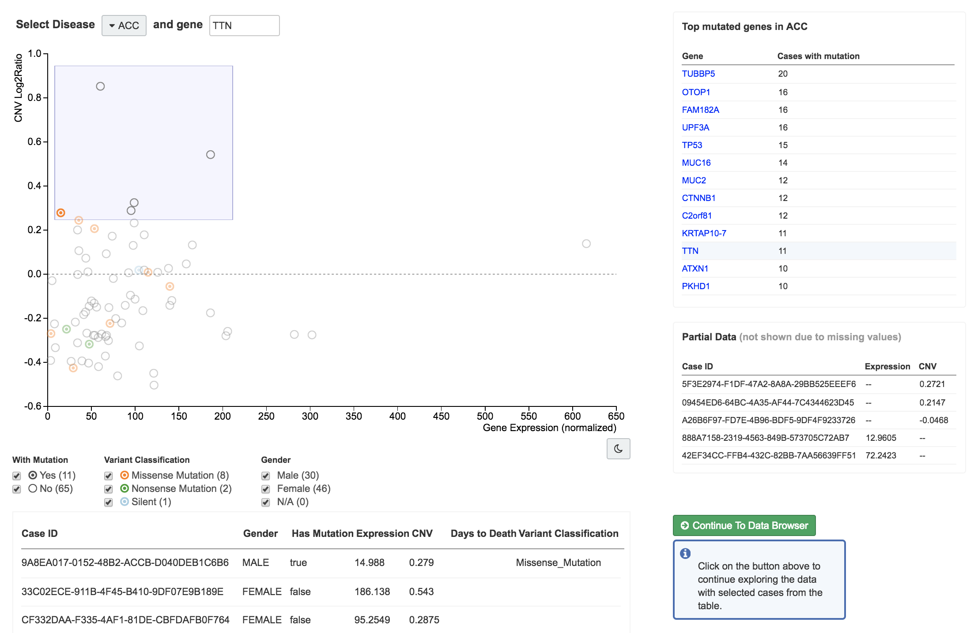
Interactive Query Tools
1
Web-based tools for exploring the data landscape and building cohorts:
Data Overview¹: At-a-glance summaries by disease type, patient gender, etc.
Case Explorer²: An interactive tool for exploring datasets using derived annotations (e.g. mutations, gene expression levels)
2

Slide 51
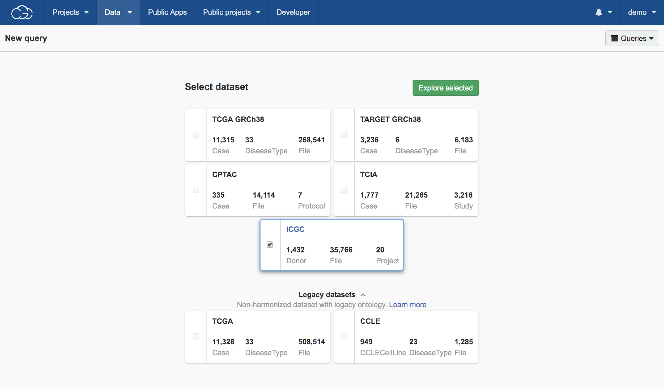
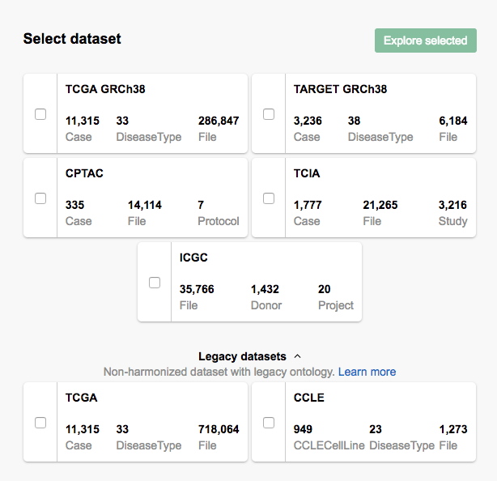
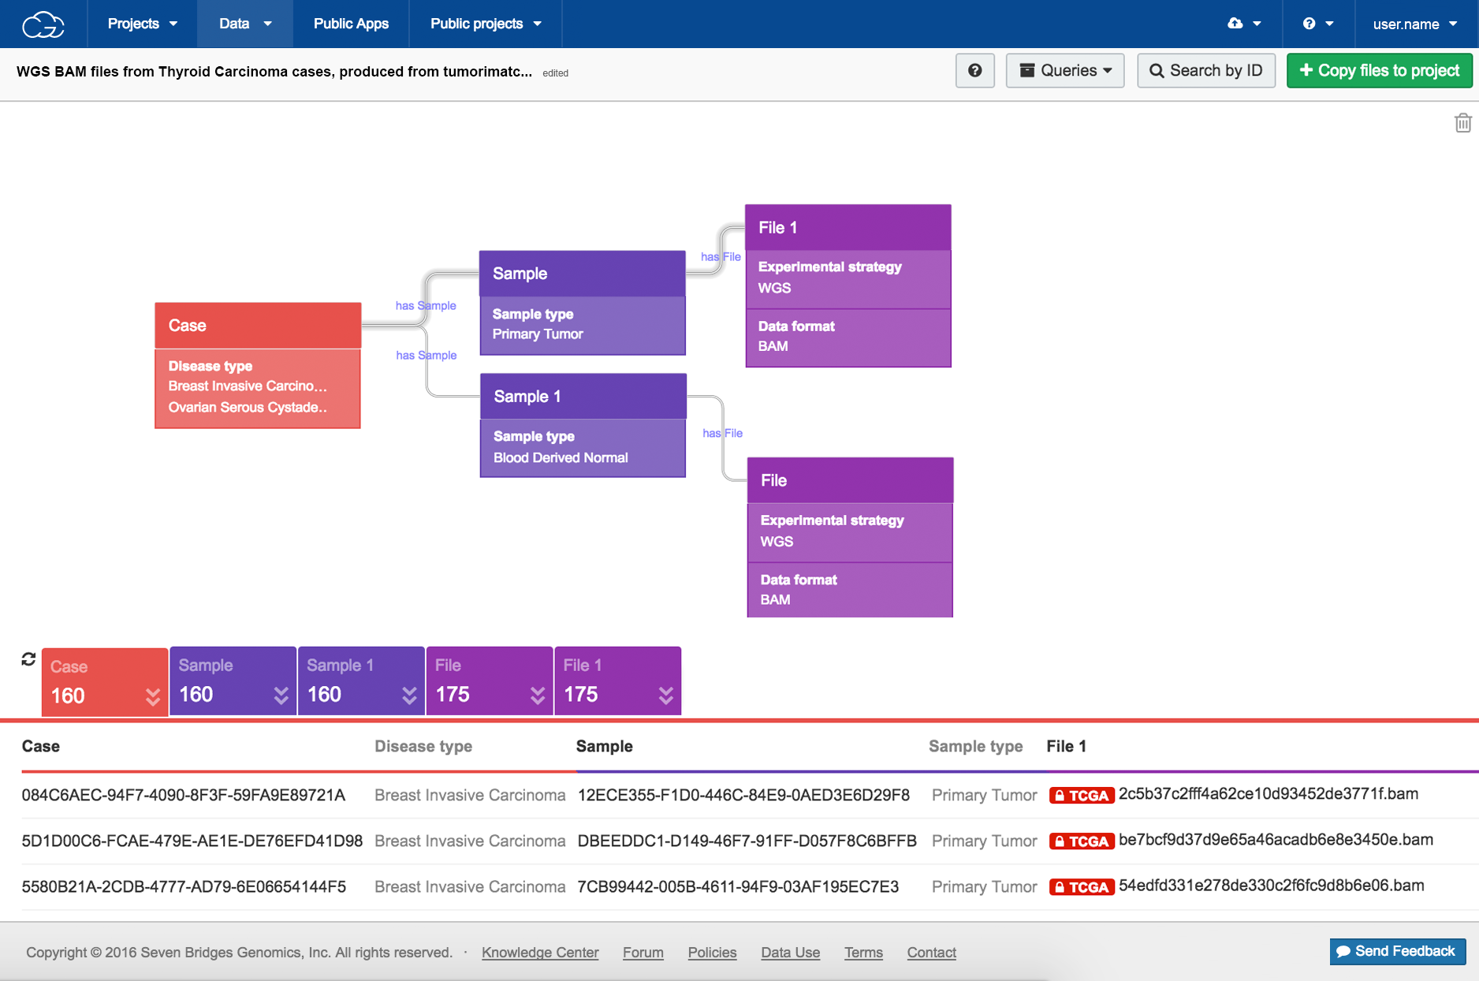
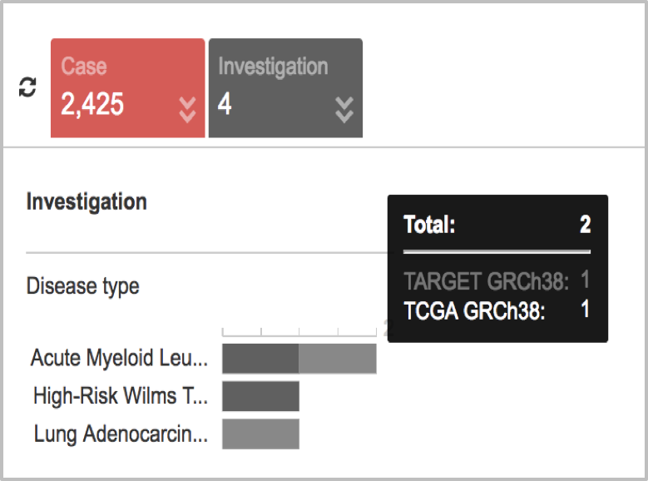
Interactive Query Tools (continued)
Web-based tools for exploring the data landscape and building cohorts:
Data Browser: An interactive tool for building custom queries
Single dataset: using >140 entities & properties (e.g. case, disease type, experimental strategy)
Multi-dataset: using shared entities & properties across harmonized datasets

Slide 52
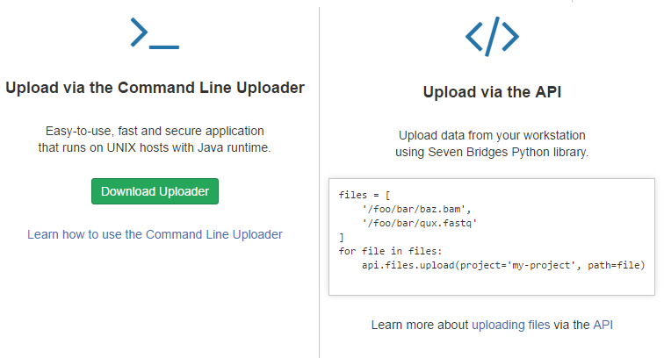


Tools To Connect Data
Import Data to the CGC:
Command Line Uploader & CLI
CGC Uploader (desktop/GUI)
API import
HTTP(S) / FTP import

Slide 53




Tools To Connect Data (continued)
Connect the CGC to External Resources:
Connect Cloud Storage (Volumes API)
SBFS (a FUSE-based file exchange)
Mount projects from your desktop

Slide 54


Tools To Analyze Data
Public Apps: A curated, searchable gallery of 350⁺ bioinformatics tools & workflows
Optimized for speed & cost in the cloud
Fully parameterized & customizable
Accessible via the GUI & API

Slide 55


Tools To Ensure Analytical Reproducibility
Use of Docker-containerized bioinformatics pipelines to provide a consistent computational environment
Automatically generated and accessible logs for every task run via the CGC
App versions
App parameters
Input & output files

Slide 56


Tools To Port Your Own Apps to the Platform
Docker:
A community standard for providing a consistent compute environment
Common Workflow Language (CWL):
A community standard for tool & workflow annotation to ensure portability & reproducibility
Rabix:
An intuitive and flexible software development kit for developing, rapidly prototyping, and porting custom tools and workflows to the CGC

Slide 57




Tools To Port Your Own Apps to the Platform (continued)
Rabix Composer:
Fully integrated with the CGC for app and data access
Provides app versioning
Enables local app development & cloud testing
Provides a graphical editor, including drag-and-drop workflow assembly
Displays in-line annotation using CWL for easy editing

Slide 58


Tools To Extend Your Analysis Ecosystem
SBFS: A FUSE-based file system that allows users to analyze data on the CGC using local (desktop) applications
Data Cruncher: A custom JupyterLab environment for interactive analysis, data visualization & implementation of custom tertiary analysis tools written in R, Python, or Julia
Files
Instance

Slide 59

Getting Started: Registration & Login
Create a new account or log in to an existing account:
via an eRA Commons or NIH CIT account
via a dedicated CGC account

Slide 60



Getting Started: Data Access
Open Data: Accessible to any registered CGC user
Controlled Data: Accessible to authorized CGC users
TCGA and TARGET data: Accessible to any user with an approved dbGaP Data Access Request via his/her eRA Commons account.
ICGC data: Accessible to any user with an approved DACO application and an AWS_DOWNLOAD access token.

Slide 61

Getting Started: Creating a Project
To create a project, specify:
Project name
Billing group
Project type: controlled or standard
demo123
demo123

Slide 62
Costs of Using the CGC
Free Credits*
CGC users pay for:
AWS S3 and Glacier storage charges for any files they upload or output files they generate
AWS EC2 charges for compute
Spot instances are available to reduce overall costs.
CGC users do NOT pay for:
Access to the platform or associated tools
Storage of public dataset files (e.g. TCGA, TARGET, ICGC)
Storage of Public Reference Files
New users: $300 in credits provided upon registration
Collaborative Projects: Up to $10,000 in credits available for approved projects
* Generously funded by the NCI. Contact the Seven Bridges CGC Team at cgc@sbgenomics.com for details.

Slide 63


AWS Costs

Slide 64



Tracking Costs
Cost Tracking: Easy user interfaces for tracking storage and compute costs, invoices, and payments
Billing groups:
Cost tracking per project
Customizable membership to support research groups and collaborations
Invoicing: Monthly
Payment Options: Purchase order or credit card

Slide 65

Additional Resources
https://docs.cancergenomicscloud.org/

Slide 66
Seven Bridges
Cancer Genomics Cloud
www.cancergenomicscloud.org
DEMO/Hands-on
https://goo.gl/f21Lqq

Slide 67
Break
Reconvene at 4PM
https://goo.gl/f21Lqq

Slide 68
Institute for Systems Biology
Cancer Genomics Cloud
www.isb-cgc.org
Presenter: Durga Addepalli
https://goo.gl/f21Lqq

Slide 69
ISB-CGC Mission
interactive web application
scripting languages: R, Python, SQL
direct programmatic access
… is to make NCI cancer genomics data sets, together with tools and compute-power, available and accessible to a broad range of users using multiple access modes:

Slide 70
ISB-CGC Mission
ISB-CGC Approach
… is to make NCI cancer genomics data sets, together with tools and compute-power, available and accessible to a broad range of users using multiple access modes
build an open platform that can grow and evolve to satisfy a broad range of users and use-cases
use existing systems where possible to minimize development and maintenance costs
leverage the best existing tools and technologies, as they are released
collaborate with the research community in areas of data standards, containers, workflows, etc
provide a range of examples and tutorials to get newcomers up and running quickly

Slide 71


Slide 72

Data Size & Complexity
DNASeq WGS
DNASeq WXS
RNASeq

Slide 73



Slide 74
TCGA, TARGET, CCLE, GTEx:
Clinical & Biospecimen information
Molecular data
mRNA, miRNA, protein expression
DNA copy-number
DNA methylation
Somatic mutations
Reference information:
Gencode, Ensembl, miRBase, …
hg19 to hg38 'liftover'
450K DNA methylation annotations
Kaviar, COSMIC, …
GDC metadata
Other publicly available resources:
Google-hosted public datasets
Tute Genomics (ANNOVAR) annotations
Your data!

Slide 75


Relationships between our BigQuery tables
Representation:
Red - TCGA table
Yellow - Reference table (eg genomic or platform reference)
Blue - metadata table (eg file manifest, or other metadata)
Green - common field in the schemas of one or more tables
used in “JOIN” and “GROUP BY” operations
Ex: map DNA methylation data onto copy-number data
Notes:
I.e. ways to join data tables

Slide 76
Example Use Cases:
annotate variants with a single query
compare hg19 and hg38 gene-expression quantification
correlate gene-expression to copy-number variation and rank genes
Pearson vs Spearman correlations
user-defined functions for more complex analysis
explore metadata to identify input files for more traditional "workflows"
analyze user-uploaded data in the context of the ISB-CGC hosted data
"publish" data, annotations, etc
more examples in our tutorials, and "Query of the Month" posts

Slide 77

A "large"
BigQuery example
Using RNA-seq expression data, compare over 10,000 TCGA samples to all 53 GTEx tissue types:
get top 5000 "most variable" genes in the GTEx dataset
get top 5000 "most variable" genes in the TCGA dataset
take intersection of these two lists (~3200 genes)
get expression data for all TCGA samples for these 3200 genes, and rank the expression values (partitioned by sample)
do the same thing with the GTEx tissue type (median expression) data
"join" the results of steps 4 and 5 on gene symbol
compute the rank-based correlation between every TCGA sample and each GTEx tissue type
finally, sort the results by correlation coefficient

Slide 78



A "large" BigQuery example
Using RNA-seq expression data, compare over 10,000 TCGA samples to all 53 GTEx tissue types:
get top 5000 "most variable" genes in the GTEx dataset
get top 5000 "most variable" genes in the TCGA dataset
take intersection of these two lists (~3200 genes)
get expression data for all TCGA samples for these 3200 genes, and rank the expression values (partitioned by sample)
do the same thing with the GTEx tissue type (median expression) data
"join" the results of steps 4 and 5 on gene symbol
compute the rank-based correlation between every TCGA sample and each GTEx tissue type
finally, sort the results by correlation coefficient
query took < 15 seconds
and cost a less than $0.10

Slide 79
Programmatic Access
The second method to interact with ISB-CGC data is through the ISB-CGC programmatic API or through other Google Cloud APIs.
The ISB-CGC API provides access to much of the same computational functionality as the web application
The other Google APIs can be used to access the hosted data sets depending on which technology is used to host them:
the BigQuery Web UI, Command-Line Tool, or REST API for the data stored in BigQuery tables;
the Google Cloud Storage (GCS) JSON API or gsutil for the data stored in GCS objects; or
the Genomics REST API for data stored in Google Genomics.
For ISB-CGC users who want to perform custom analyses by writing R or Python scripts, there two public github repositories: examples-Python and examples-R.
R users can work from the familiar environment of RStudio
Python programmers can enjoy the richness available in IPython notebooks by taking advantage of the newly released Cloud Datalab
Notes:
Google BigQuery is well integrated with a variety of other tools -- allowing computational users to perform custom and ad-hoc analyses using their language/workspace of choice

Slide 80





plays well with others
Cloud Datalab
bigrquery and
bigQueryR
googleAuthR
Cloud notebooks
and workspaces.
Pre-built VM images
Query of the Month Club
Notes:
Google BigQuery is well integrated with a variety of other tools -- allowing computational users to perform custom and ad-hoc analyses using their language/workspace of choice

Slide 81


web access for the PI / biologist
custom cohort definition
interactive data visualizations
Define a cohort based on
clinical information (eg diagnosis, subtype, gender, survival, etc)
data-availability (eg DNA methylation, miRNA, somatic mutations, radiology and/or diagnostic images, etc)
molecular phenotypes (eg TP53 mutation, EGFR amplification, etc)

Slide 82

web access for the PI / biologist
Analyses,
Gene and miRNA Lists,
Variable Lists,
Cohorts, and
Saved Programs

Slide 83

Notes:
Now, let's go back and consider those 2 petabytes of raw sequence data, and let's also think about a more complete end-to-end workflow.
Say you have a new scientific research question that requires DNA and RNA from tumor-normal pairs.
You would start by using our APIs or or web-application to define a cohort of cases for which both tumor and normal samples exist, as well as both DNA and RNA sequence data.
Based on this cohort, you would then get a list of BAM files available in Google Cloud Storage (GCS)
You would also need to dockerize whatever tools or methods needed to process the data to answer your question, and
define the "workflow" or series of steps that make up your analysis, and
finally run the workflow on all of the input files, writing the results to your own workspace in Cloud Storage
for computationally-intense processing of the low-level sequence data, users must "dockerize" their application and can then easily use Google tools such as dsub, or workflows such as CWL and WDL. Input data is typically copied from Cloud Storage to the VM's local disks, processed, and then outputs are copied back to the user's bucket in GCS.

Slide 84
Accessing ISB-CGC - Creating an account
You can just “sign in” to the web-app using your Google identity.
However, to run big jobs using Google Compute Engine on the TCGA data hosted by the ISB-CGC, You will need to request a Google Cloud Platform (GCP) project. To request an ISB-CGC funded Google Cloud Platform (GCP) project, please send a request to request-gcp@isb-cgc.org.
Your GCP project gives you access to all of the technologies that make up the Google Cloud Platform (GCP). These technologies include BigQuery, Cloud Storage, Compute Engine, Google Genomics, etc. The ISB-CGC makes use of a variety of these technologies to provide access to the TCGA data, without necessarily inserting an extra interface layer between you and the GCP.
The connection between your GCP project (whether it is an ISB-CGC sponsored and funded project or your own personal project) and the ISB-CGC is your Google identity (also referred to as your “user credentials”). Access to all ISB-CGC hosted data is controlled using access control lists (ACLs) which define the permissions attached to each dataset, bucket, or object.
Accessing Controlled Data
Through interactive computing (eg the Web App or R Studio),
or programmatically (eg a program running from a Google Virtual Machine Compute Engine you have started)
first associate (or “link”) your Google identity (which you use to sign in to the ISB-CGC Web App and access the Google Cloud) with a valid NIH login associated with a dbGaP data-access request
This is done through the Web App

Slide 85
ISB-CGC “Cloud Credits” Available for Researchers
Tier 1 | $300 Free Trial | New Google Cloud Platform (GCP) users
Tier 2 | $1,000 | Provide details about project goals, expected costs, etc, and provide feedback to ISB-CGC team
Tier 3 | Up to $10,000 | Provide project details such as scientific goals, collaboration details, etc, and provide feedback
Tier 4 | More than $10,000 | Available in exceptional cases, if researchers can justify the need for additional support. Requires approval by NCI program office
User-Paid account
All ISB-CGC provided “cloud credits” must be used within ISB-CGC provided GCP projects.
For tier 3 (and 4) projects, the ISB-CGC team will work closely with researchers in order to optimize efficiency and minimize costs.
Notes:
For each of the four ISB-CGC credit tiers above, the ISB-CGC team will coordinate directly with individual researchers as needed.
(This could be in the form of a bioarxiv manuscript, a blog post, open-source software on github, etc.)
Researchers are strongly encouraged to make workflows, software, and related documentation publicly available to benefit the broader research community.

Slide 86
ISB-CGC BigQuery Costs
Each project you create has a billing account attached to it. Storage and analysis costs are billed to the attached billing account.
You can view costs and trends by using the Cloud Billing Reports page in the Cloud Console.
Active storage | $0.02 per GB | The first 10 GB is free each month.
Long-term storage | $0.01 per GB | The first 10 GB is free each month. If a table is not edited for 90 consecutive days, the price of storage for that table automatically drops by approximately 50 percent.
Queries (analysis) | $5 per TB | First 1 TB per month is free
Queries are billed according to how much data is scanned during the course of the query, |  | $5 per TB the first 1 TB is free each month
Flat-rate pricing is also available for high-volume customers.
BigQuery operations that are free | Loading, Copying, Exporting, Deleting, Metadata operations,Reading pseudo columns,Reading meta tables
Notes:
For each of the four ISB-CGC credit tiers above, the ISB-CGC team will coordinate directly with individual researchers as needed.
(This could be in the form of a bioarxiv manuscript, a blog post, open-source software on github, etc.)
Researchers are strongly encouraged to make workflows, software, and related documentation publicly available to benefit the broader research community.

Slide 87




Some workflows enabled for ISB-CGC end-users
Multiple PanCanAtlas projects, including:
Germline-variant calling
Fusion gene analysis
T-cell and B-cell receptor analysis
viral DNA screening
MYC pathway analysis (BQ)
8-oxoG filtering (MC3 project)
Other end-user projects include:
SMC-RNA Dream challenge (supporting both the organizers and many participants)
tumor-specific alternative polyadenylation
ML algorithm evaluation & benchmarking
RNA seq alignment to novel transcriptome(s)
mRNA expression quantitation
targeted de-novo assembly
structural variations (WGS + SNP6 data)
metagenomics / cancer analysis
statistical meta-analysis of miRNAs in cancer
code/tutorial development
GDC hg38 TCGA miRNA QC (w/ BCGSC)
with several manuscripts and grants currently in progress or submitted
Notes:
And indeed a number of research teams have made use of the ISB-CGC tools and resources to do ground-breaking and innovative analyses … some of which have already been published, with many more in submission or in progress ...

Slide 88

Additional Resources
https://isb-cancer-genomics-cloud.readthedocs.io/en/latest/index.html

Slide 89
Institute for Systems Biology
Cancer Genomics Cloud
www.isb-cgc.org
DEMO/Hands-on
https://goo.gl/f21Lqq

Slide 90
Questions?
https://goo.gl/f21Lqq

Slide 94
Extra Slides

Slide 95


Example: The TCGA Dataset
by Disease Type & Experimental Strategy
Harmonized (hg38)
Legacy (hg19)

Slide 96


Example: The TARGET and CCLE Datasets
by Disease Type & Experimental Strategy
Harmonized (hg38)

Slide 97


ISB-CGC Team
Sheila Reynolds
Bill Longabaugh
Bill Clifford
David Gibbs
Ilya Shmulevich
Jennifer Dougherty
Joe Slagel
Suzanne Paquette
David Pot
Bin Hu
John Phan
Madelyn Reyes
Mark Backus

Slide 98









Interactive Tools
Pathology and Radiology images in Cloud Storage
Machine Learning & Integrative Analyses
Automated Segmentation &
Feature Extraction

Slide 99
A "large" BigQuery example
Using RNA-seq expression data, compare over 10,000 TCGA samples to all 53 GTEx tissue types:
get top 5000 "most variable" genes in the GTEx dataset
get top 5000 "most variable" genes in the TCGA dataset
take intersection of these two lists (~3200 genes)
get expression data for all TCGA samples for these 3200 genes, and rank the expression values (partitioned by sample)
do the same thing with the GTEx tissue type (median expression) data
"join" the results of steps 4 and 5 on gene symbol
compute the rank-based correlation between every TCGA sample and each GTEx tissue type
finally, sort the results by correlation coefficient

Slide 100
A "large" BigQuery example
Using RNA-seq expression data, compare over 10,000 TCGA samples to all 53 GTEx tissue types:
get top 5000 "most variable" genes in the GTEx dataset
get top 5000 "most variable" genes in the TCGA dataset
take intersection of these two lists (~3200 genes)
get expression data for all TCGA samples for these 3200 genes, and rank the expression values (partitioned by sample)
do the same thing with the GTEx tissue type (median expression) data
"join" the results of steps 4 and 5 on gene symbol
compute the rank-based correlation between every TCGA sample and each GTEx tissue type
finally, sort the results by correlation coefficient

Slide 101
A "large" BigQuery example
Using RNA-seq expression data, compare over 10,000 TCGA samples to all 53 GTEx tissue types:
get top 5000 "most variable" genes in the GTEx dataset
get top 5000 "most variable" genes in the TCGA dataset
take intersection of these two lists (~3200 genes)
get expression data for all TCGA samples for these 3200 genes, and rank the expression values (partitioned by sample)
do the same thing with the GTEx tissue type (median expression) data
"join" the results of steps 4 and 5 on gene symbol
compute the rank-based correlation between every TCGA sample and each GTEx tissue type
finally, sort the results by correlation coefficient

Slide 102

R Shiny Apps using BigQuery on the backend for interactive visualizations.
Notes:
example R/Shiny app -- one easy way to share/publish interactive tools or analyses ...

Slide 103

1. create/define cohort
2. list of files in GCS
3. dockerize tools
4. define "workflow"
5. run workflow on all input files, write outputs to GCS
6. downstream analysis of outputs
Notes:
Now, let's go back and consider those 2 petabytes of raw sequence data, and let's also think about a more complete end-to-end workflow.
Say you have a new scientific research question that requires DNA and RNA from tumor-normal pairs.
You would start by using our APIs or or web-application to define a cohort of cases for which both tumor and normal samples exist, as well as both DNA and RNA sequence data.
Based on this cohort, you would then get a list of BAM files available in Google Cloud Storage (GCS)
You would also need to dockerize whatever tools or methods needed to process the data to answer your question, and
define the "workflow" or series of steps that make up your analysis, and
finally run the workflow on all of the input files, writing the results to your own workspace in Cloud Storage

Slide 104

1. create/define cohort
2. list of files in GCS
3. dockerize tools
4. define workflow (CWL)
5. run workflow on all input files, write outputs to GCS and/or BQ
6. downstream analysis of outputs
Notes:
but of course at this point you're not done -- it's likely that you will still need to do significant downstream analysis of the initial results that were produced by your workflow
this is where uploading your results into other available technologies such as Google BigQuery or Google Genomics will allow you to analyze your results, alongside other TCGA or TARGET resources, or other reference datasets … for example you might look for correlations between your results and clinical data, or you might annotate genomic regions using GENCODE or ENSEMBL ...

Slide 105
Notes:
Both TCGA data tables contain sample barcodes, allowing information from each table that pertains to the same sample to be merged into a single output row by a JOIN operation.
However, neither the copy-number nor the methylation table schemas include a field with a gene symbol which is another common way to JOIN one molecular data table to another. Instead, the methylation annotation table (yellow node) can be used to find the chromosomal coordinate for each methylation probe (by performing a JOIN operation on the probe id), and then the chromosomal coordinate of the probe can be used to find relevant copy-number segments in the copy-number table.

